Slide 1
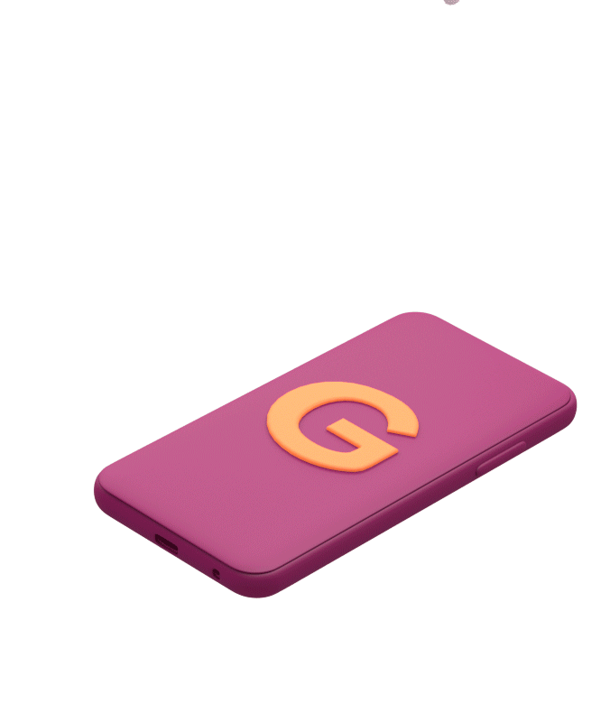
Welcome to Gympass!
A discovery platform that helps you stay active - anytime, anywhere.
Notes:
This presentation’s client is the HRs

Slide 2
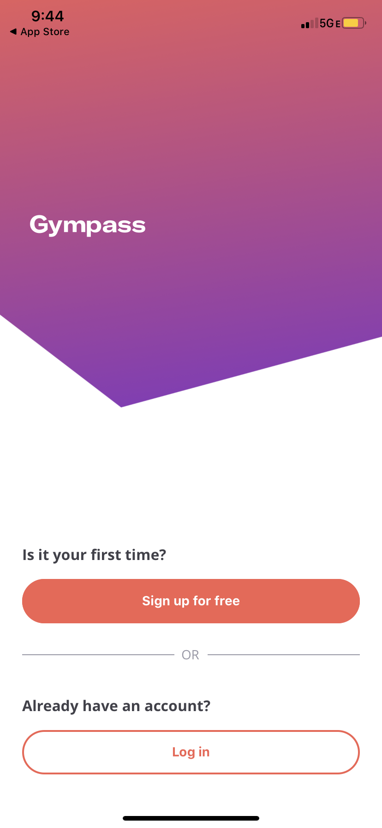
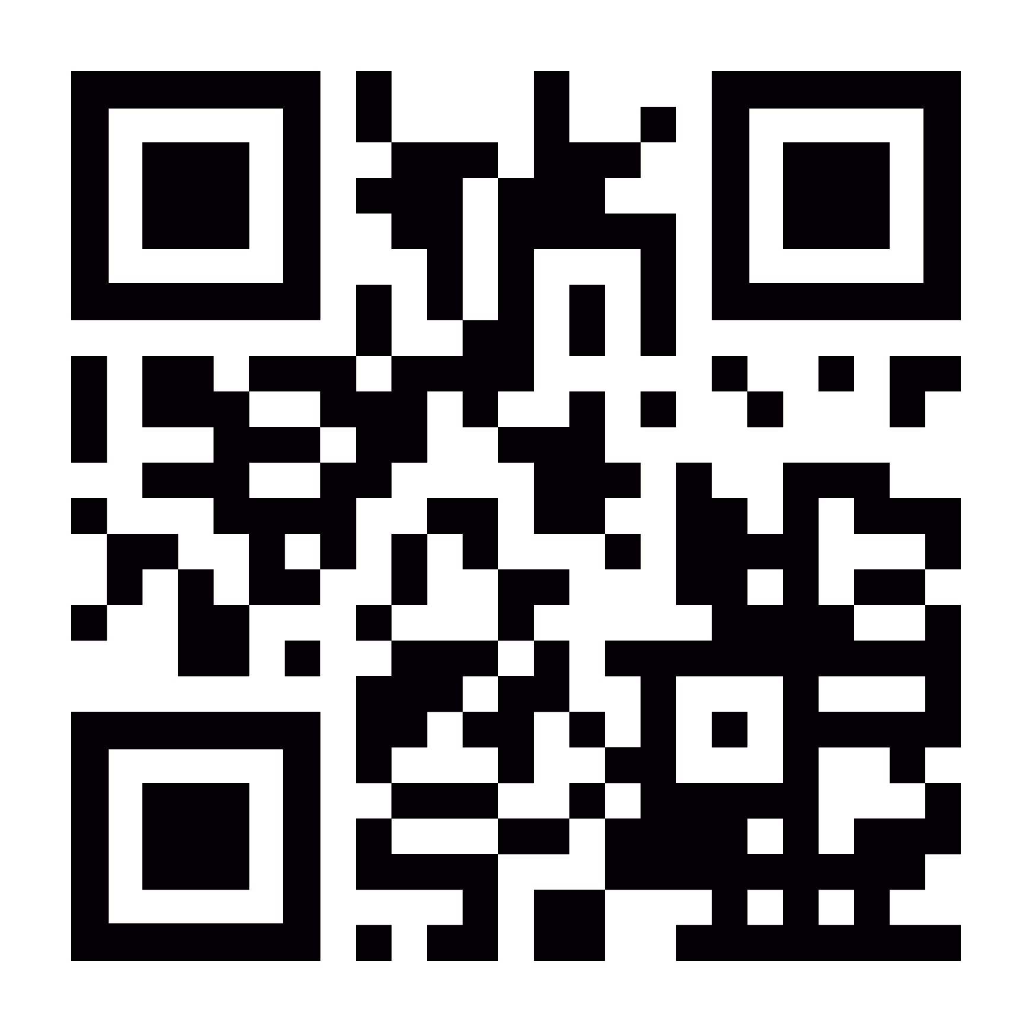
Getting started with
Gympass is quick and easy!
1
Download the app on your smartphone
Create a free account with your
work email or employee ID
Choose a plan that works for you and enter your payment information to activate your membership
2
3
App Store
Google Play
Scan here to download!

Slide 3
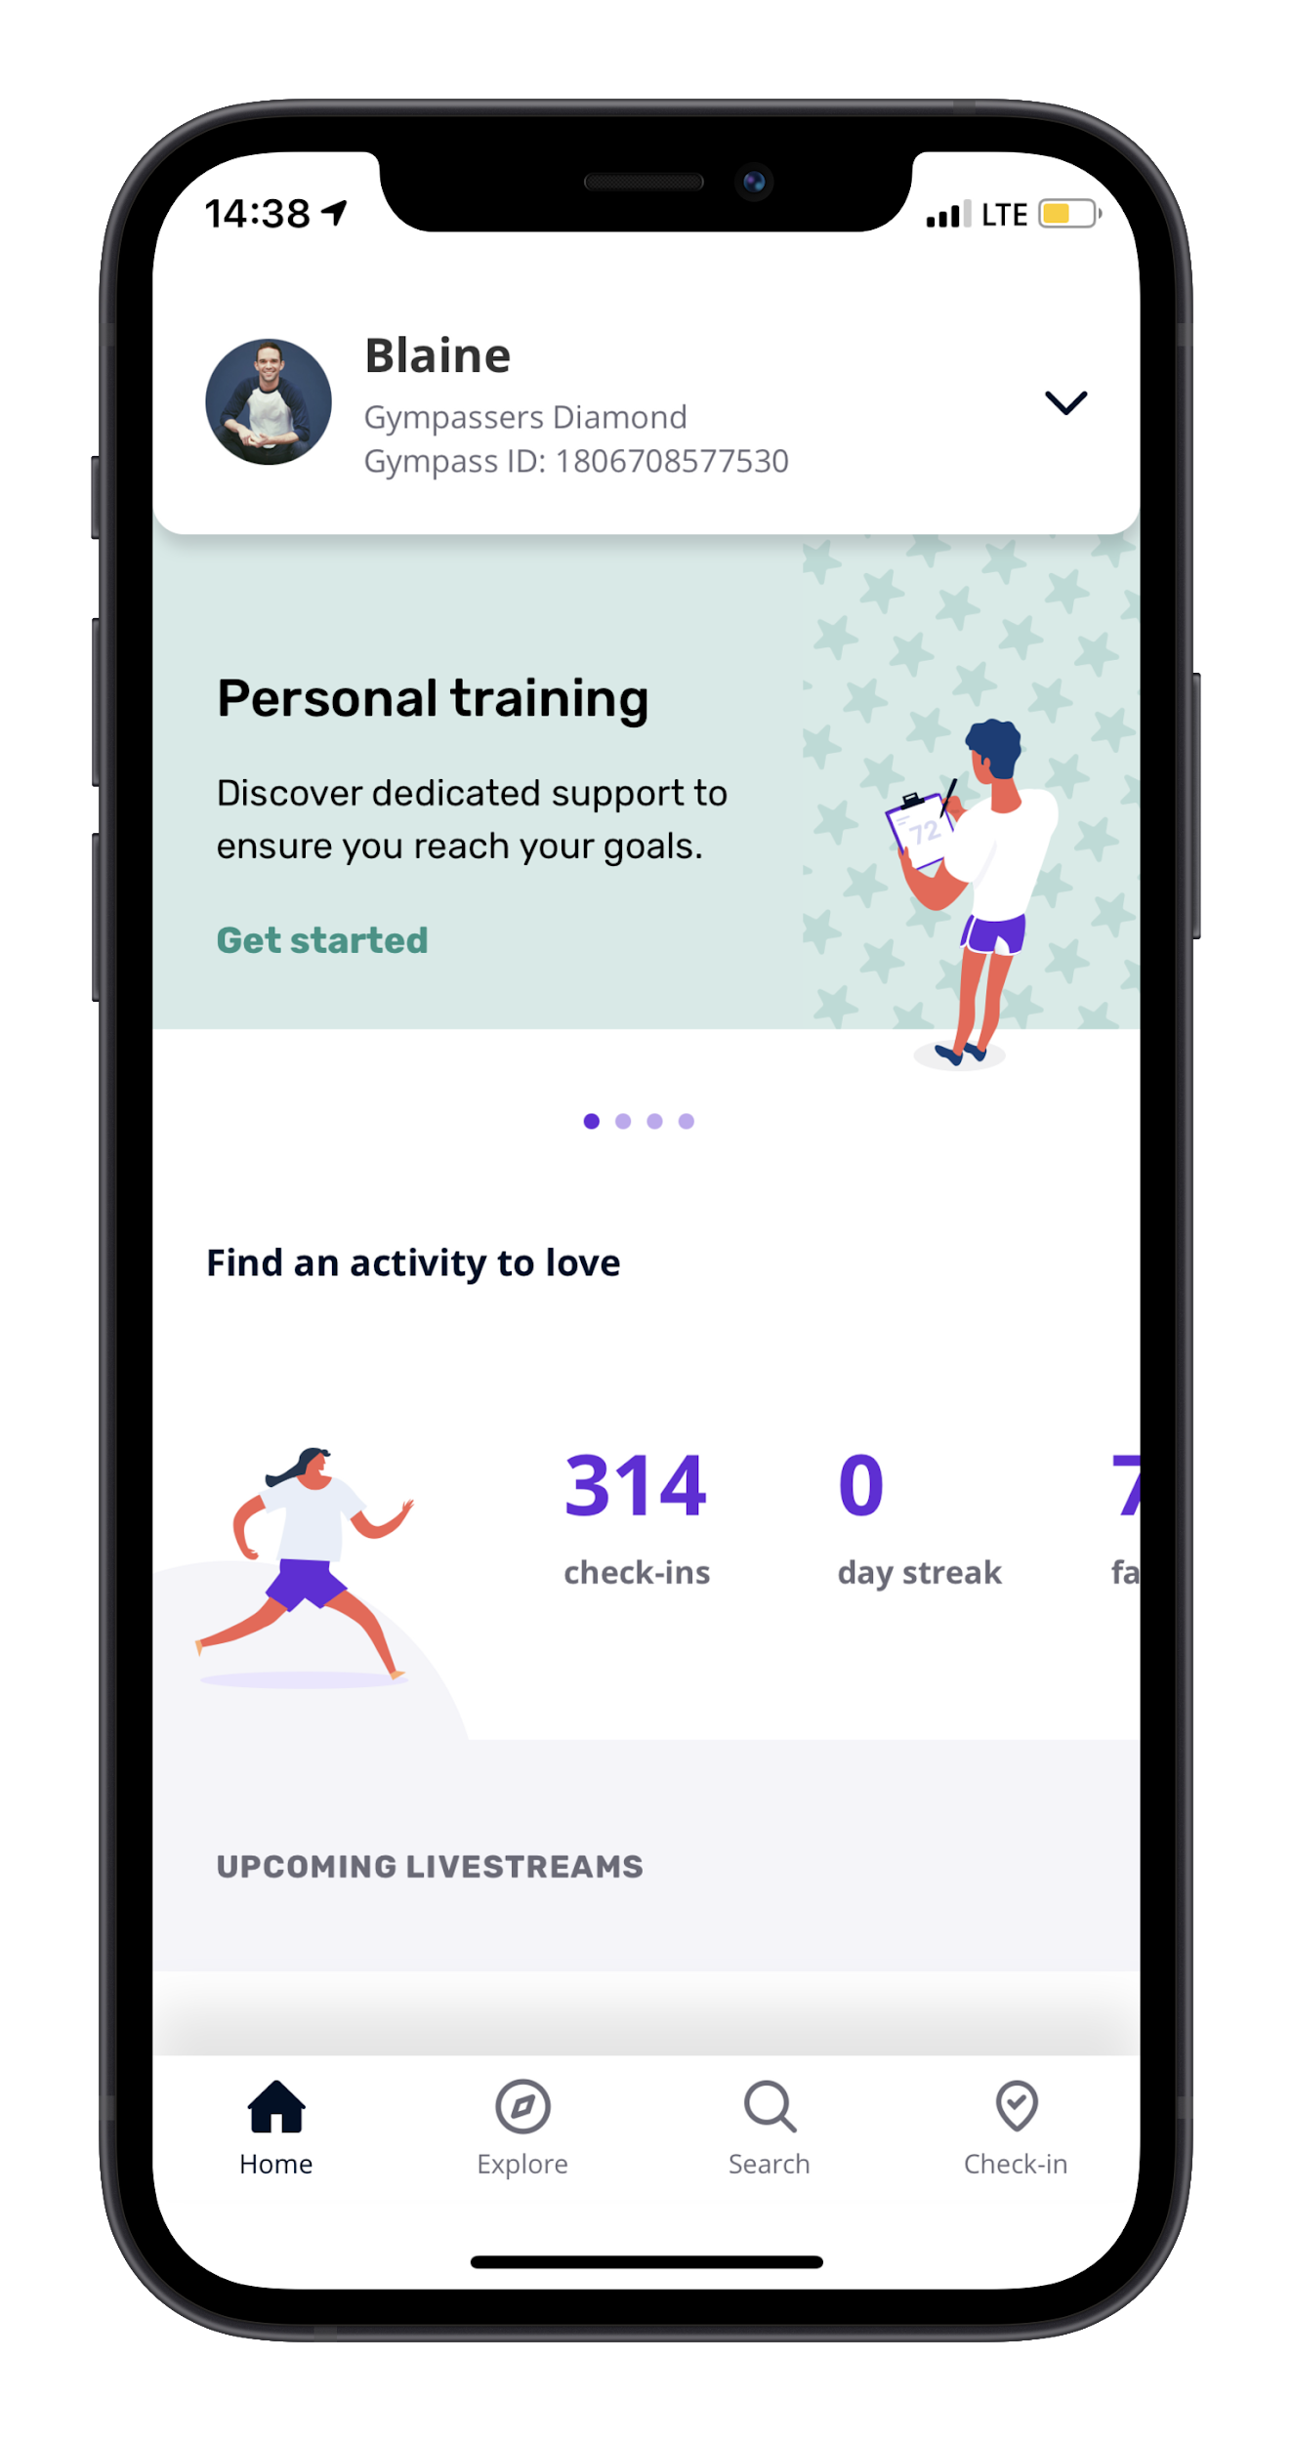
Gympass ID
Manage your account
This is where your Gympass ID is located
Change your account settings, refer a facility, or upgrade or downgrade your plan here
Account Features
Swipe here to explore Gympass Personal Trainers, Apps, Interactive Group Classes, and adding Dependents
Track your progress
See your gym check ins
and visits here
Upcoming Livestream Schedule
Want to book something now? Check out our upcoming live classes
Check into a gym
Explore Tab
Click here and head to reception
to validate your check-in
Explore Live Classes, Personal Training, Wellness Coaches, and Apps

Slide 4
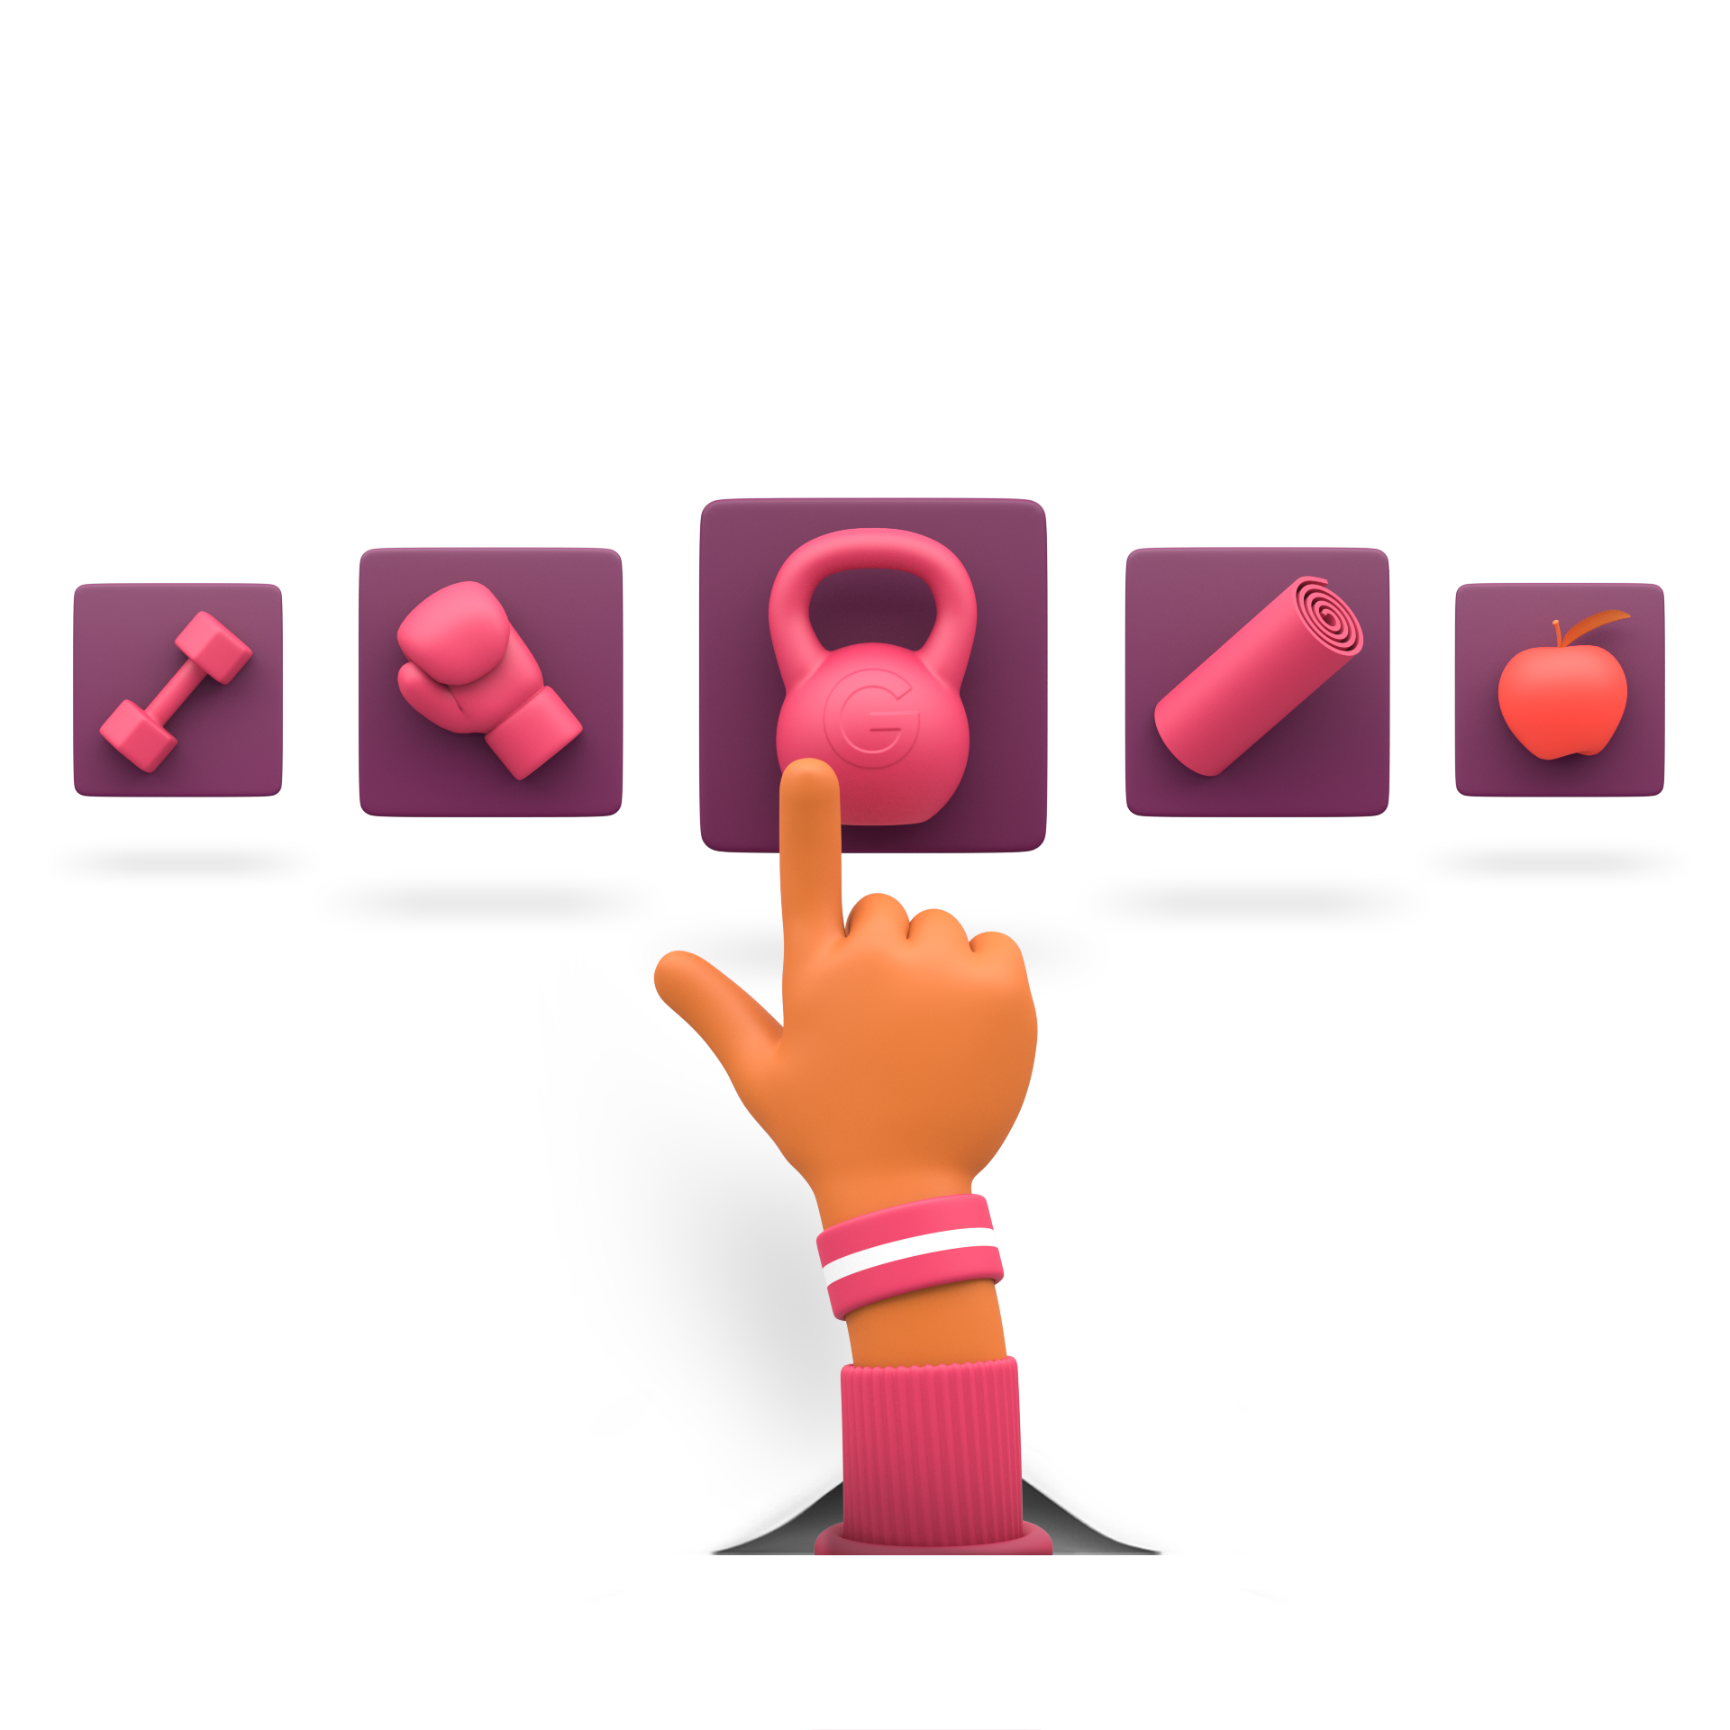
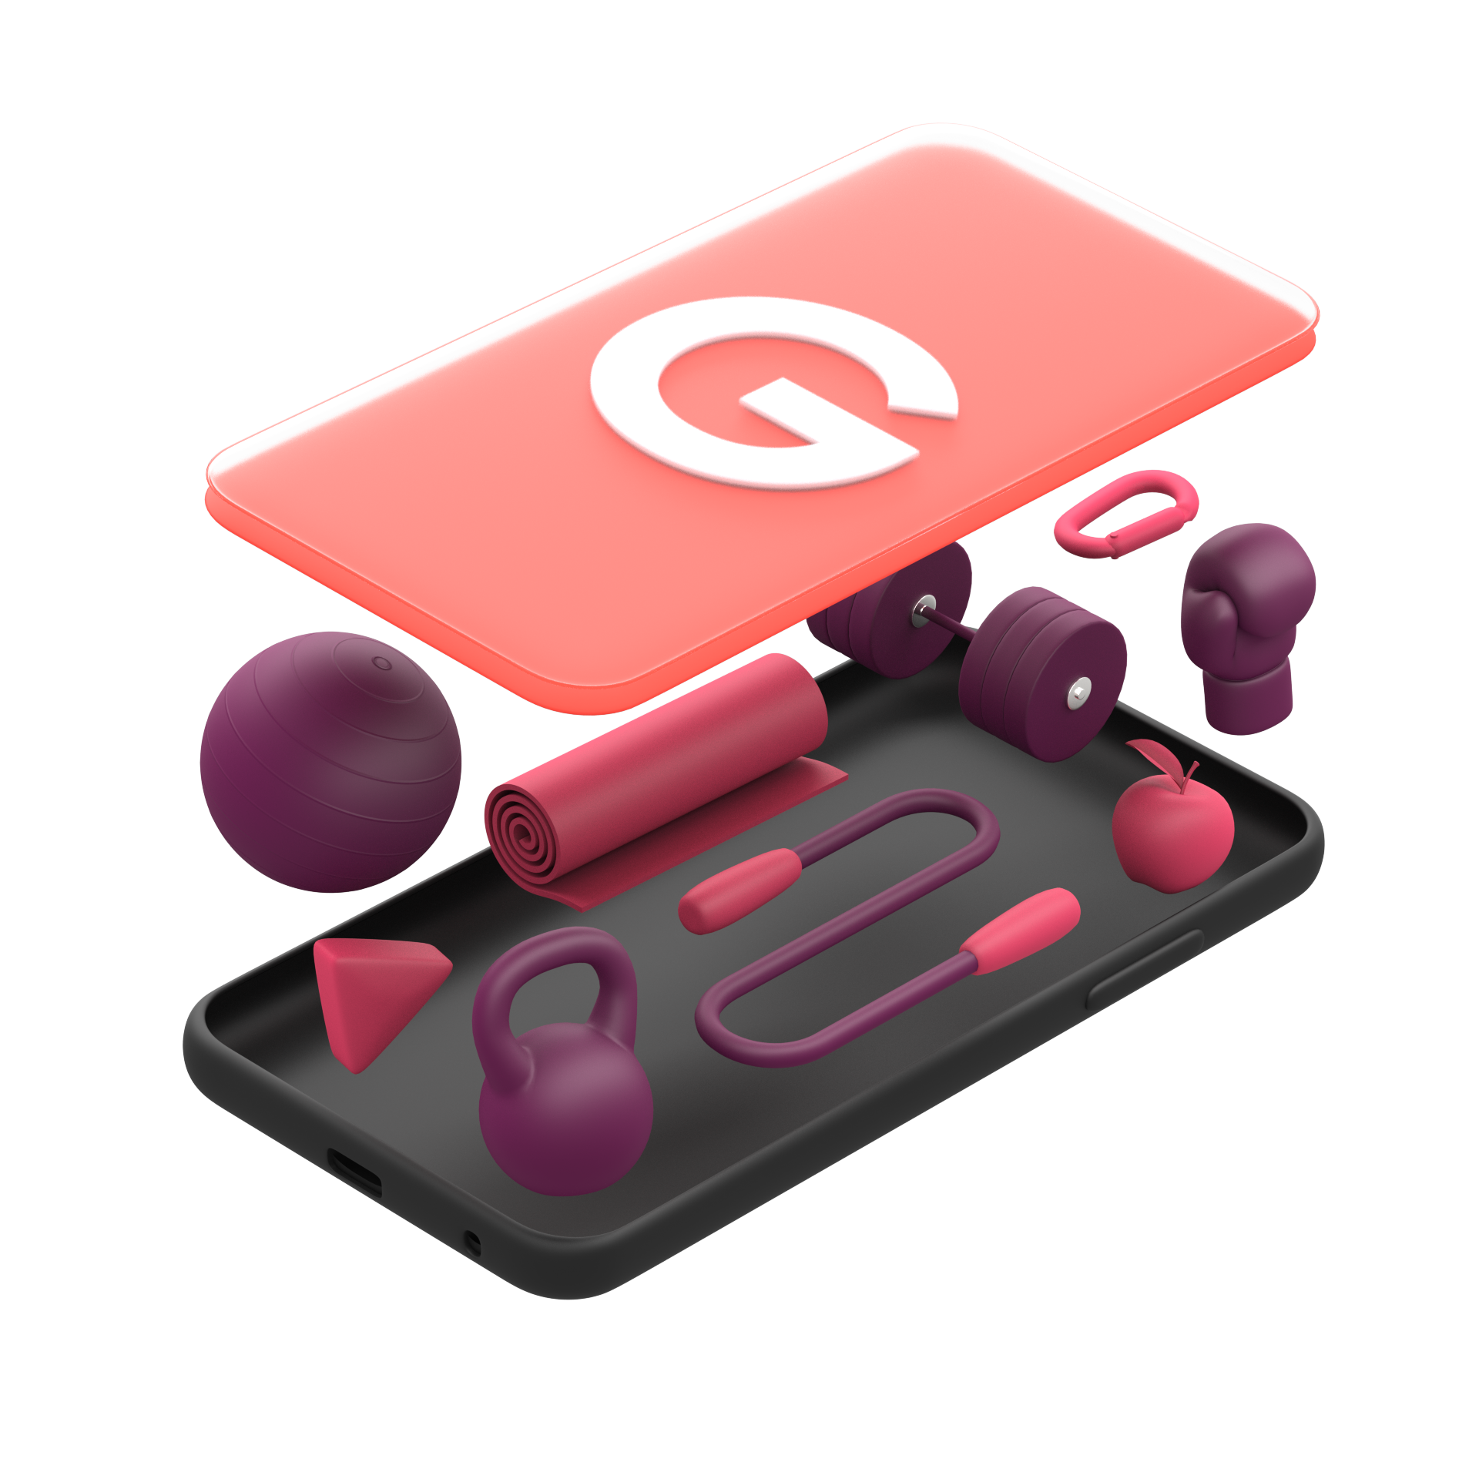
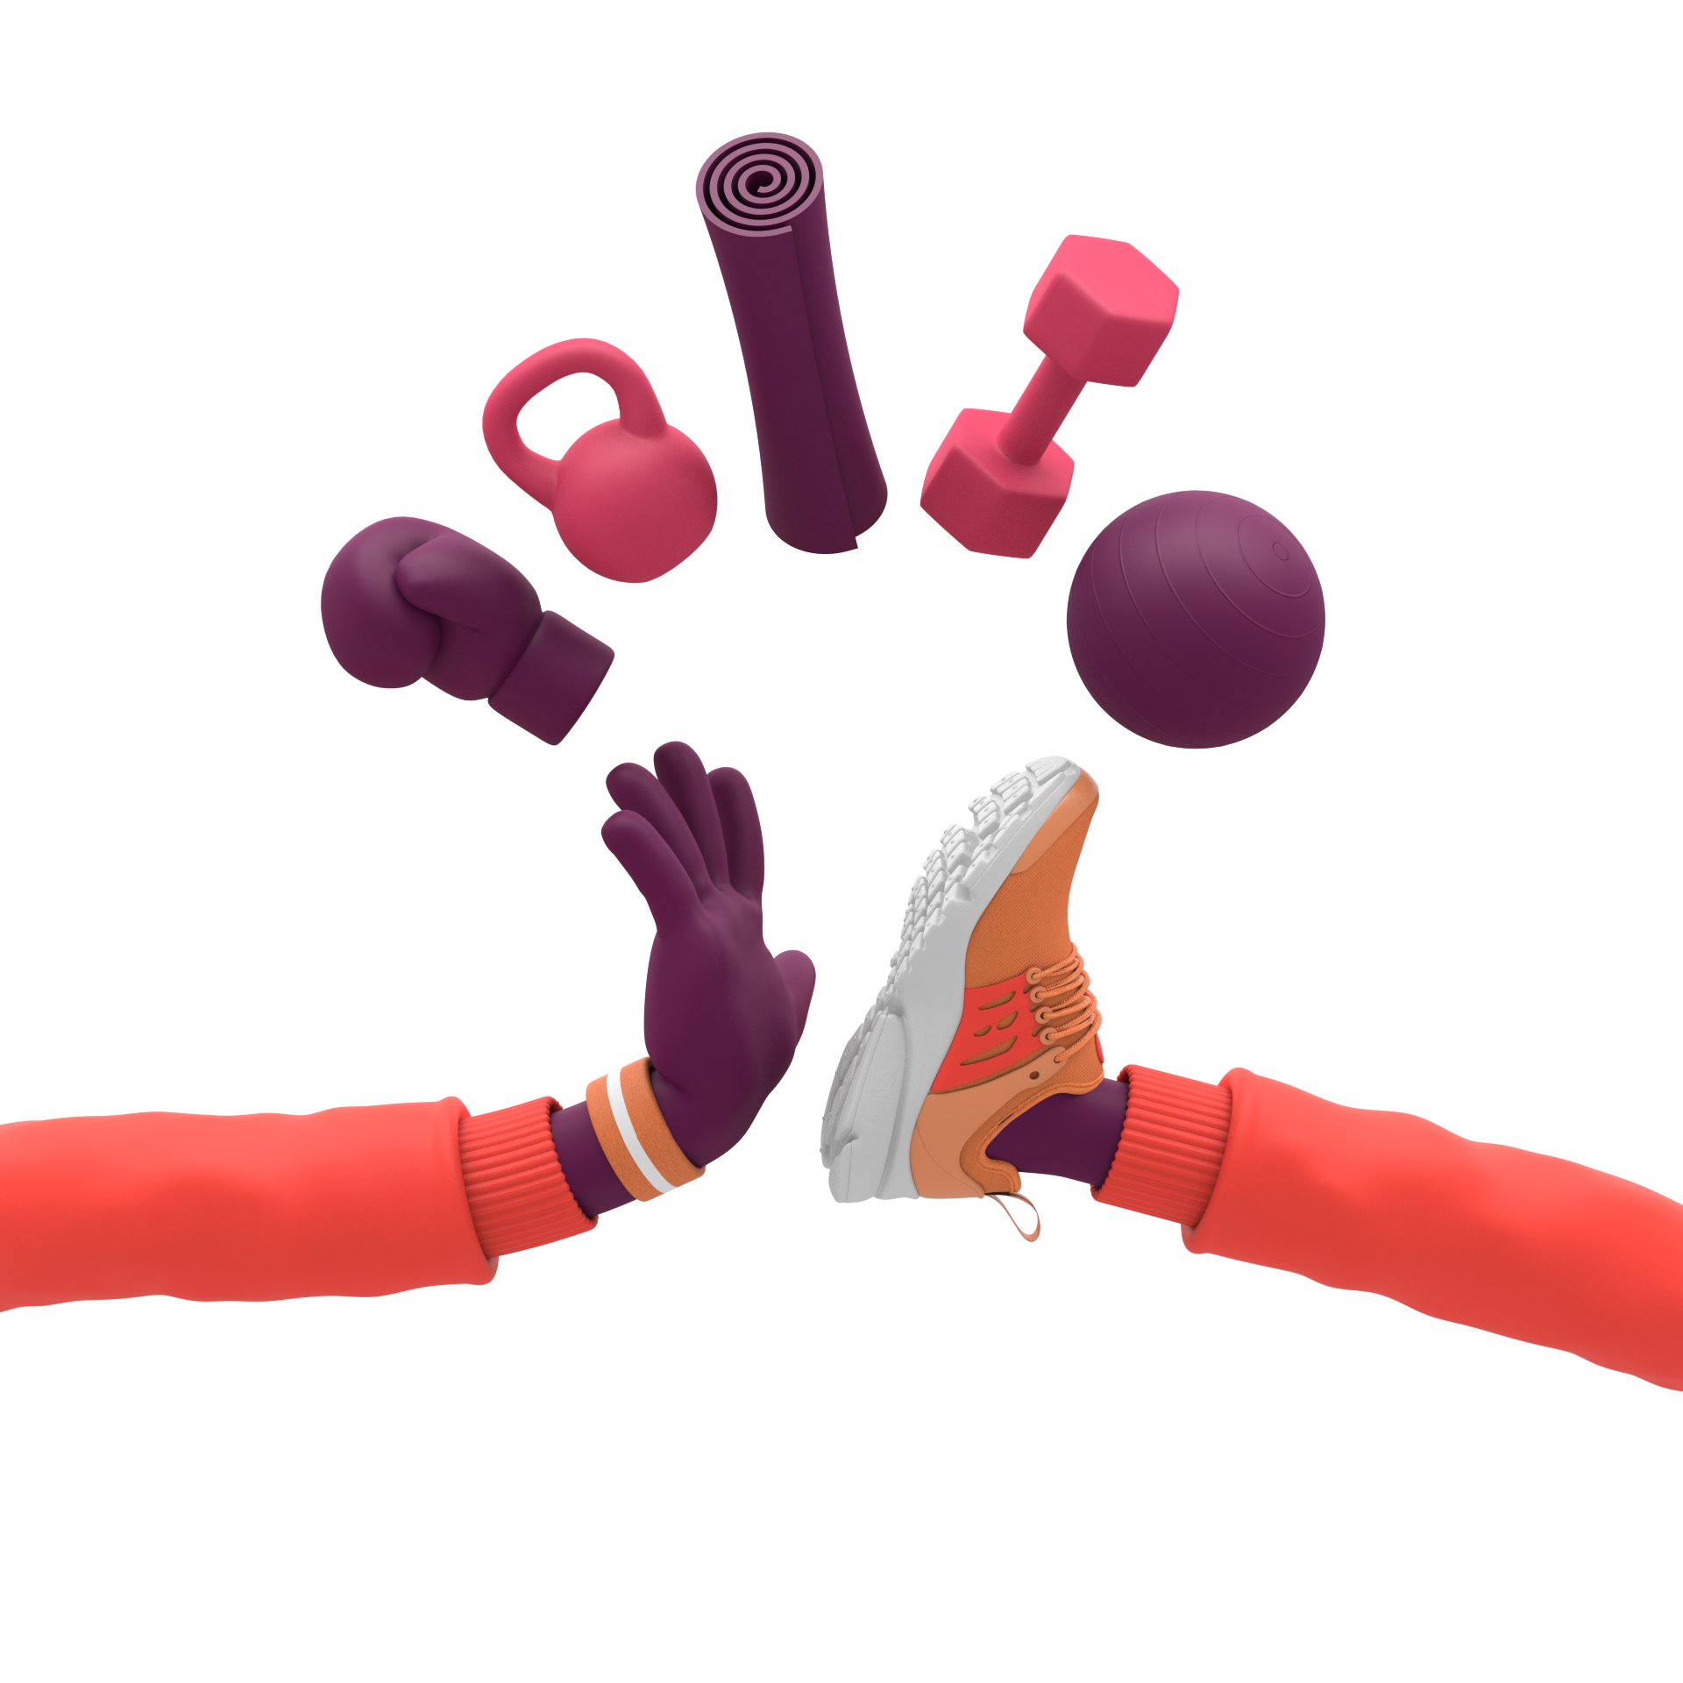
With one Month-to-Month Membership
Gyms & Fitness Studios
Live Streamed
Classes
1-on-1
Personal Training
App Partners &
On Demand Workouts

Slide 5
With one Month-to-Month Membership
Gyms & Fitness Studios
Live Streamed
Classes
1-on-1
Personal Training
App Partners &
On Demand Workouts

Slide 6
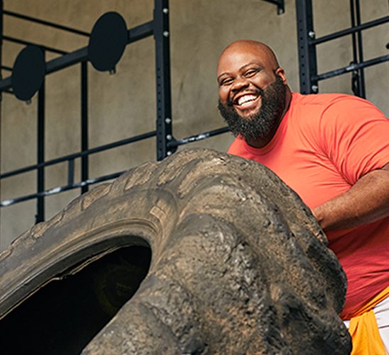
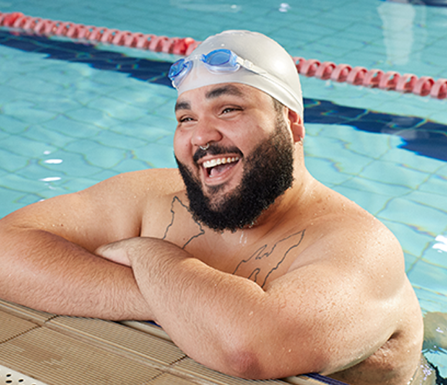
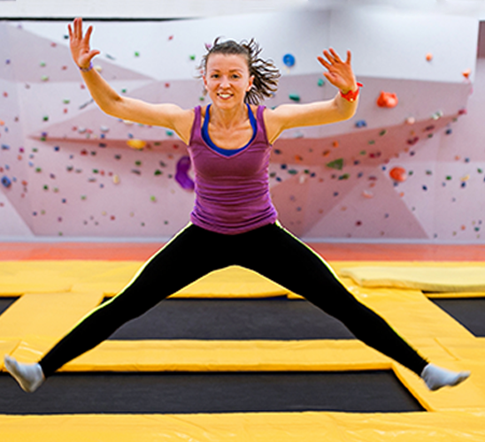
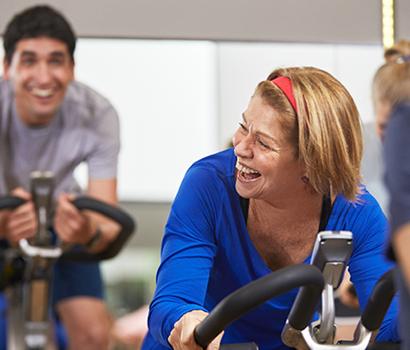
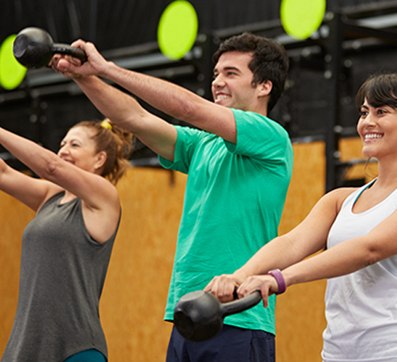
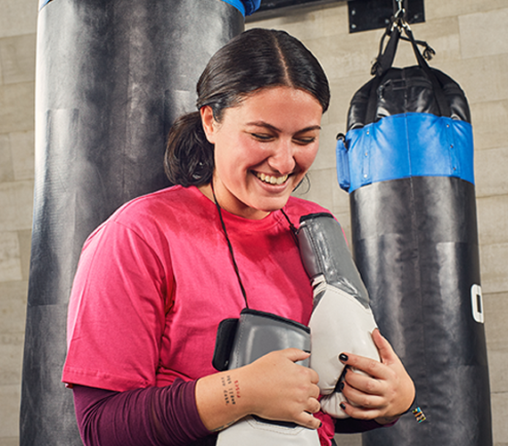
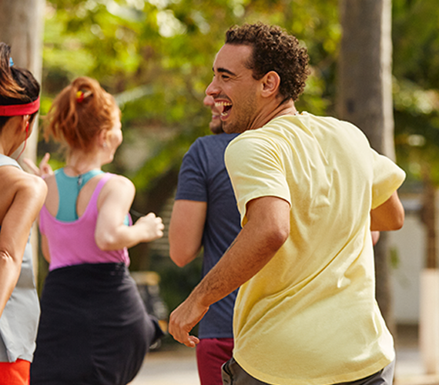
We partner with more than 50,000 locations worldwide,
with over 900 different workouts for you to try!
Crossfit
Pilates
Muay Thai
Weight Lifting
Swimming
Trampoline
Yoga
Jiu-jitsu
HIIT
Spinning
Functional
Training
Boxing
Strength
Training
Running
Zumba

Slide 7
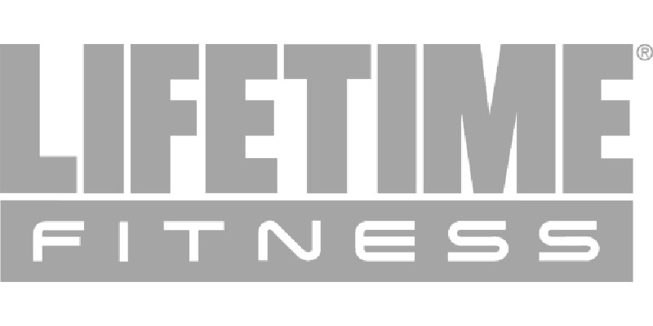
Fitness
Partners
More than 12,000
facilities in the US
..and many more!

Slide 8
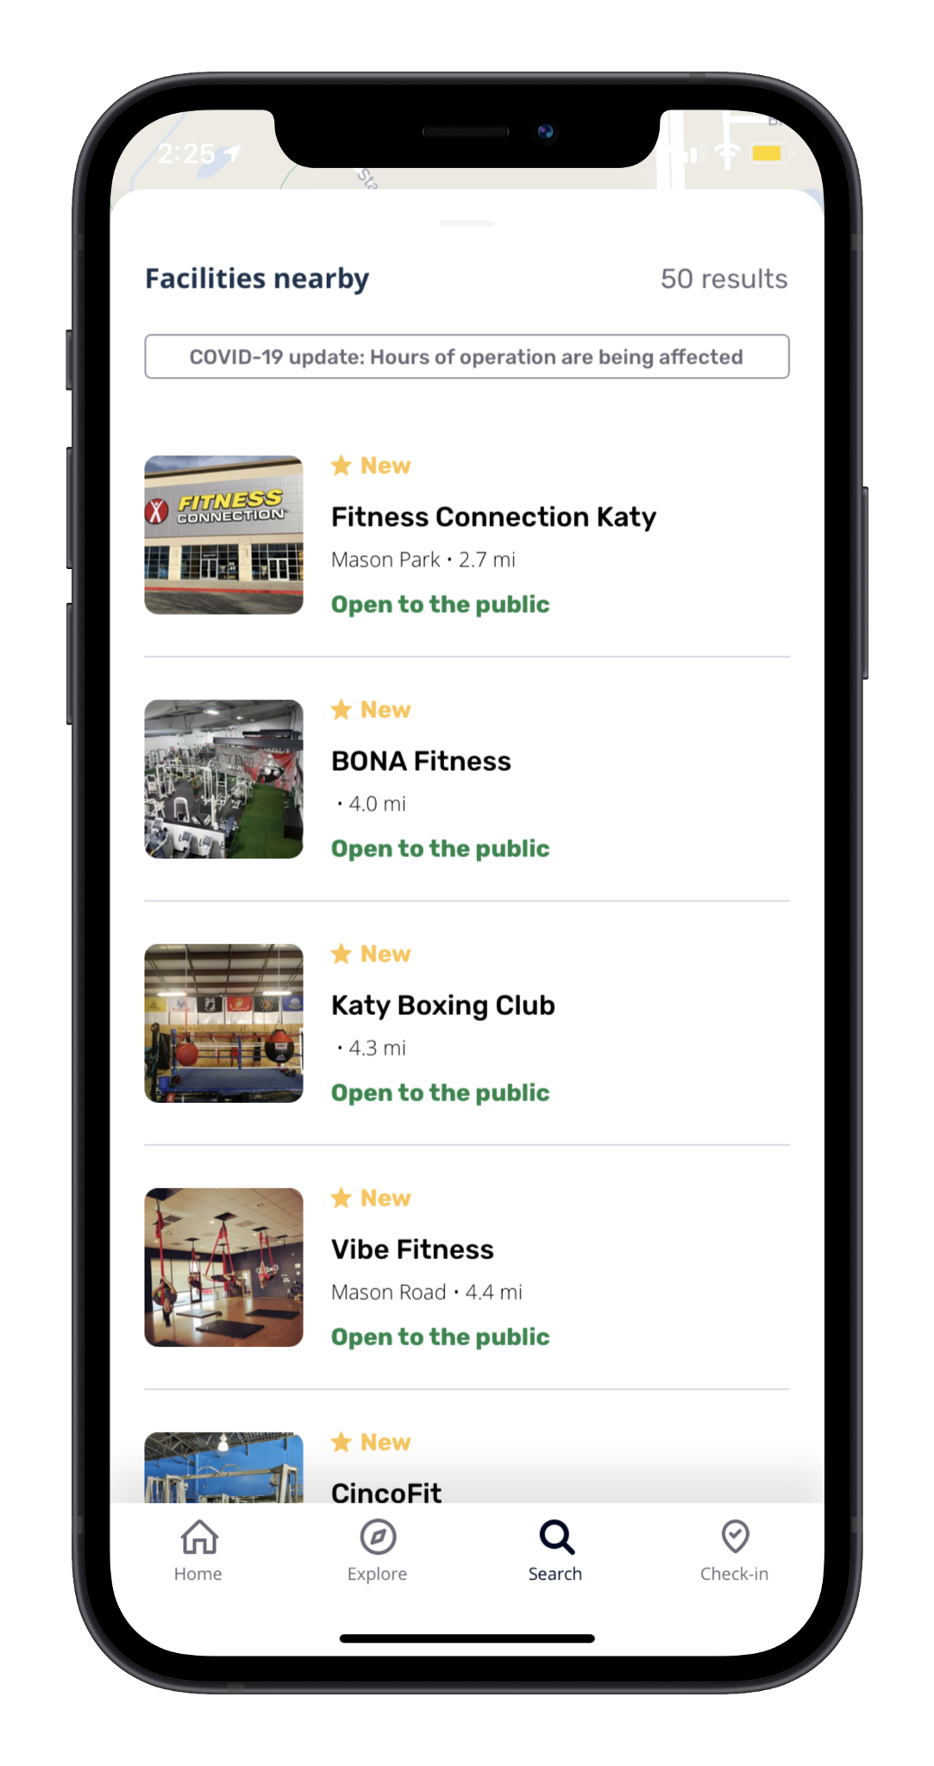
Exploring Nearby Facilities
Click “Search”
Swipe Up On “Facilities Nearby”

Slide 9
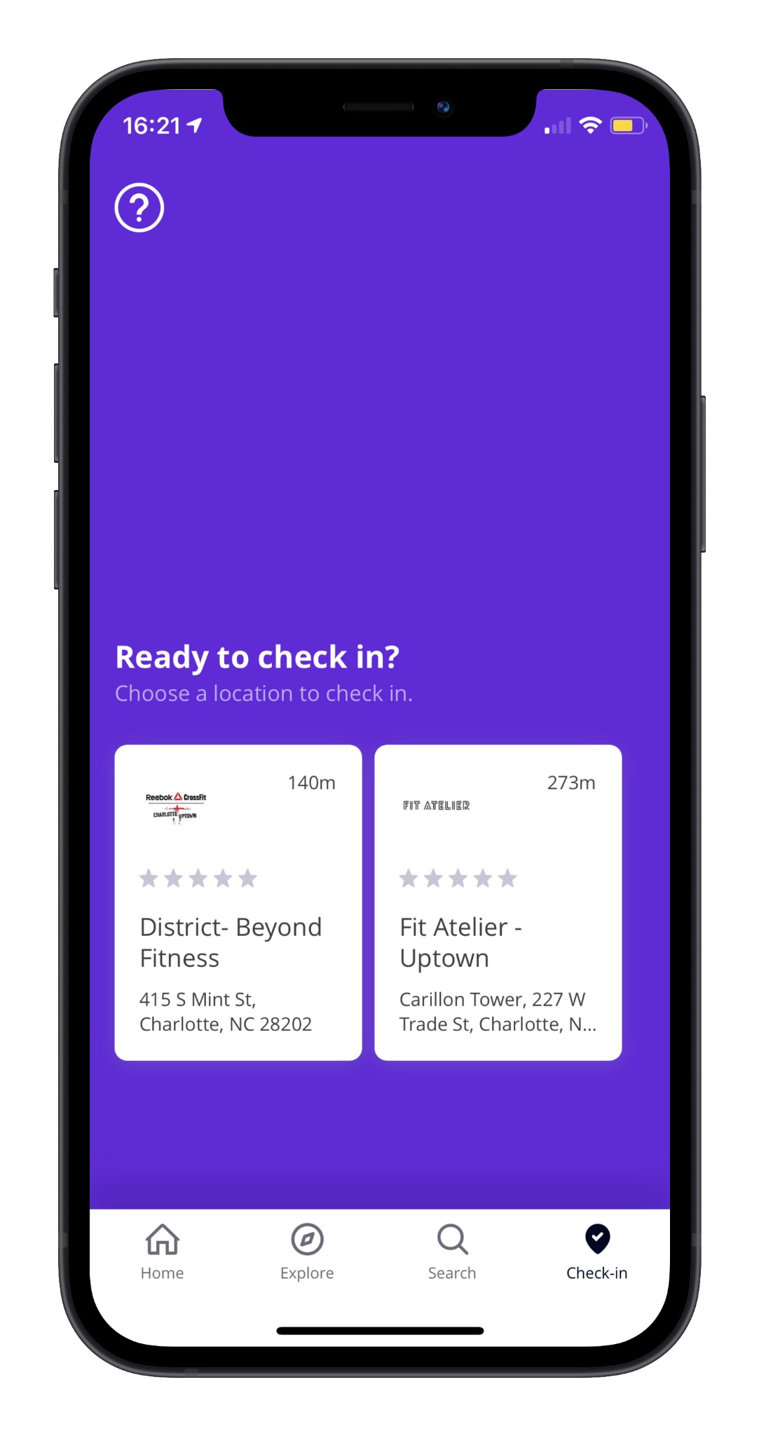
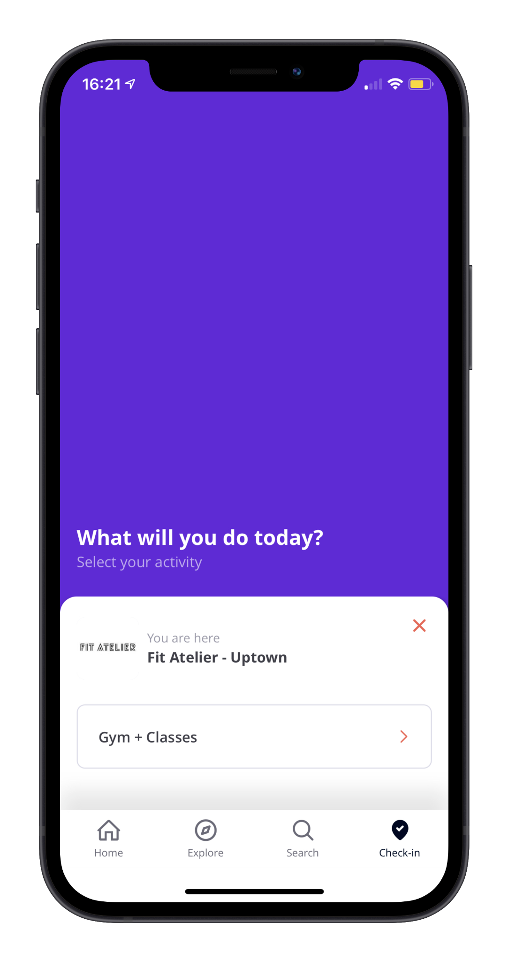
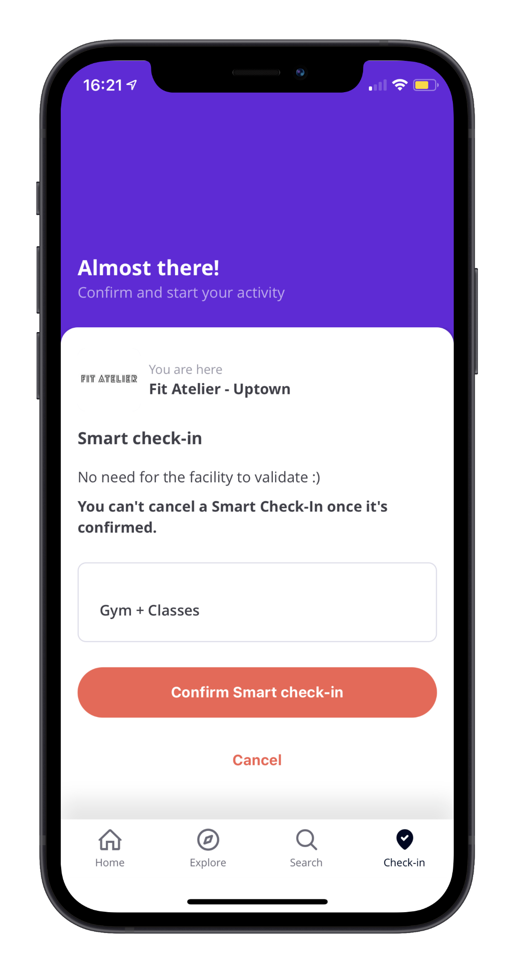
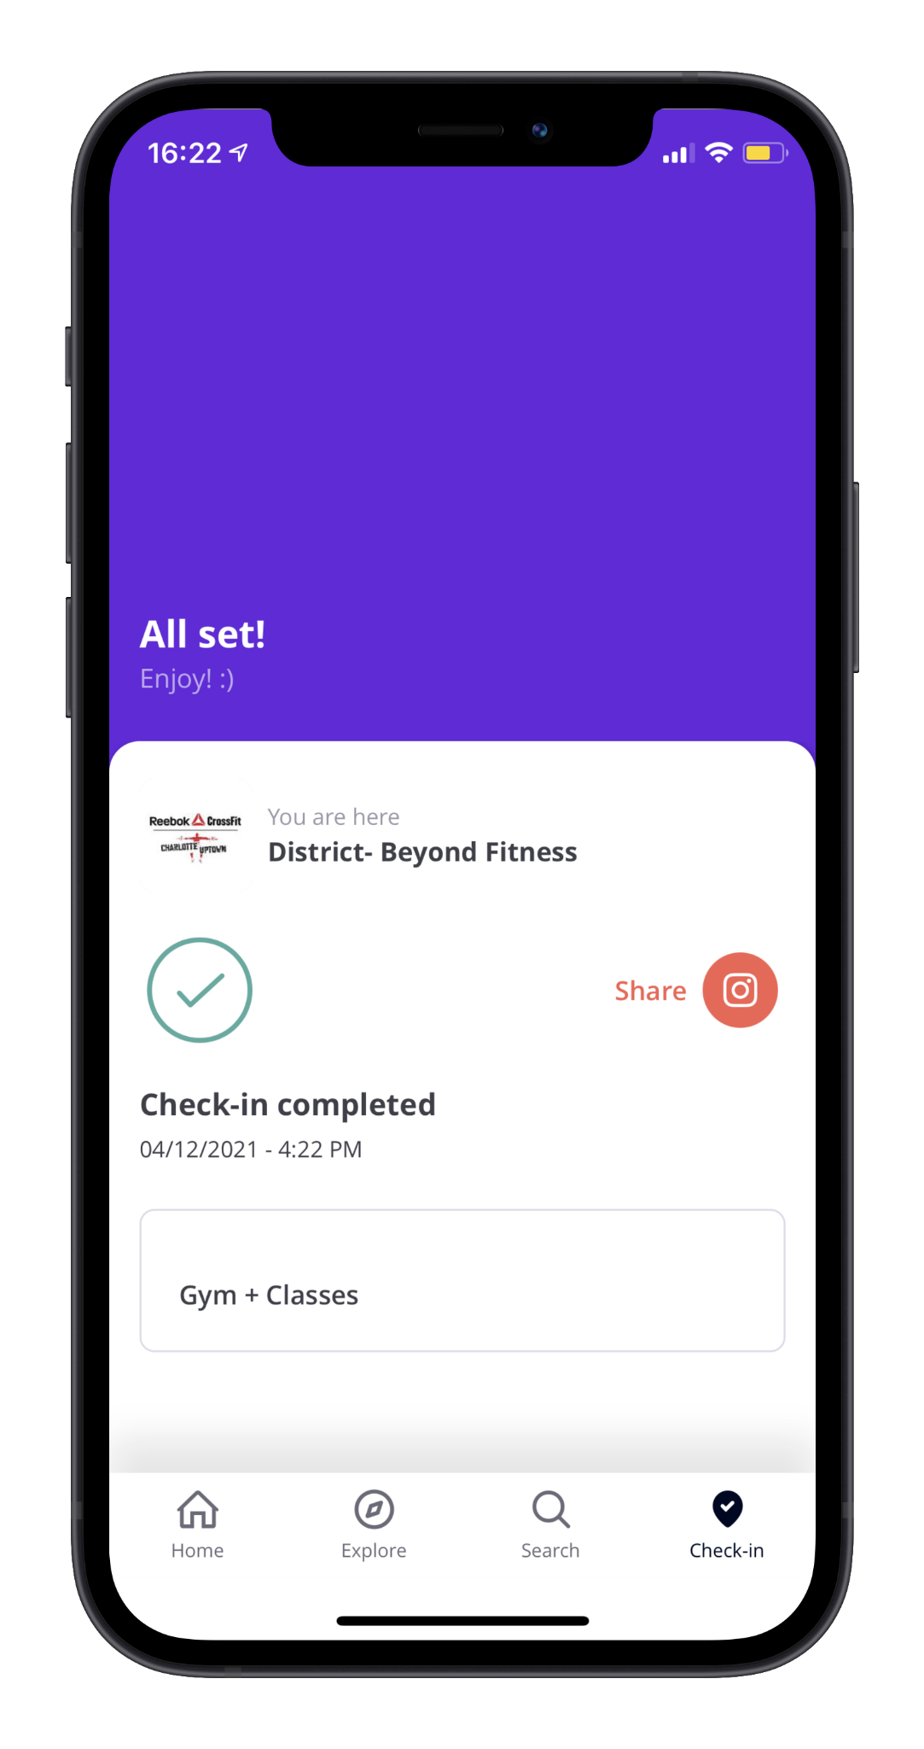
Checking In To A Facility
Click “Check-In” and select which facility you are attending
Select which activity you will be doing at the facility
Show the receptionist at the facility and enjoy your workout!
Click “Confirm Smart check-in”

Slide 10
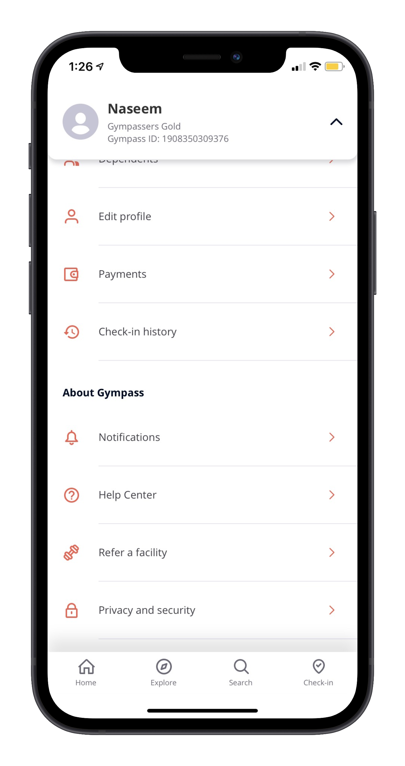
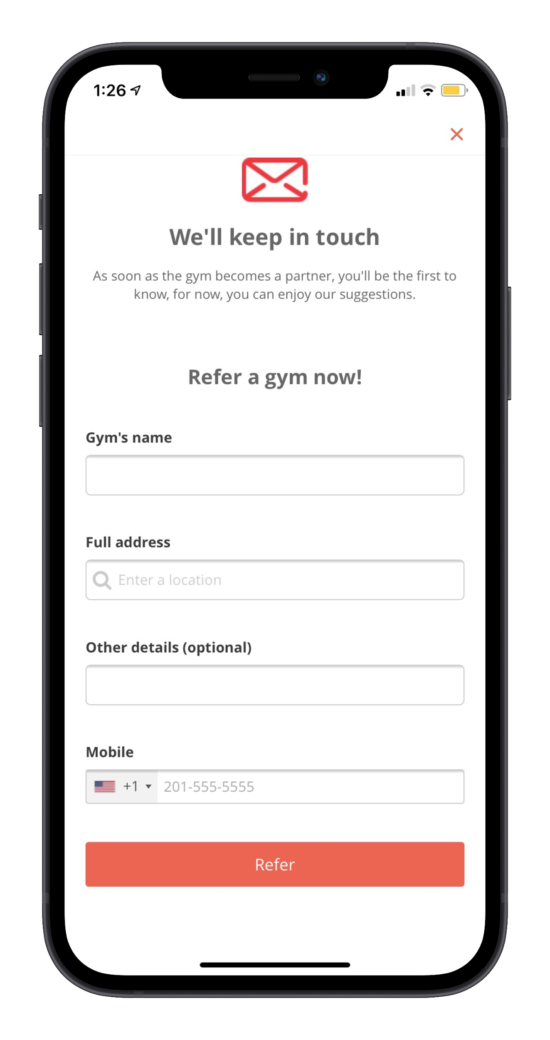
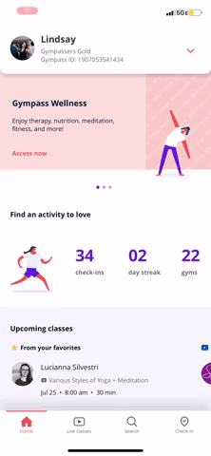
Refer your favorite Gym:
1
Home → Drop Down Menu
2
Click “Refer a facility”
3
Enter the Gym’s Info
2
Select “Refer a facility”

Slide 11
With one Month-to-Month Membership
Gyms & Fitness Studios
Live Streamed
Classes
1-on-1
Personal Training
App Partners &
On Demand Workouts

Slide 12
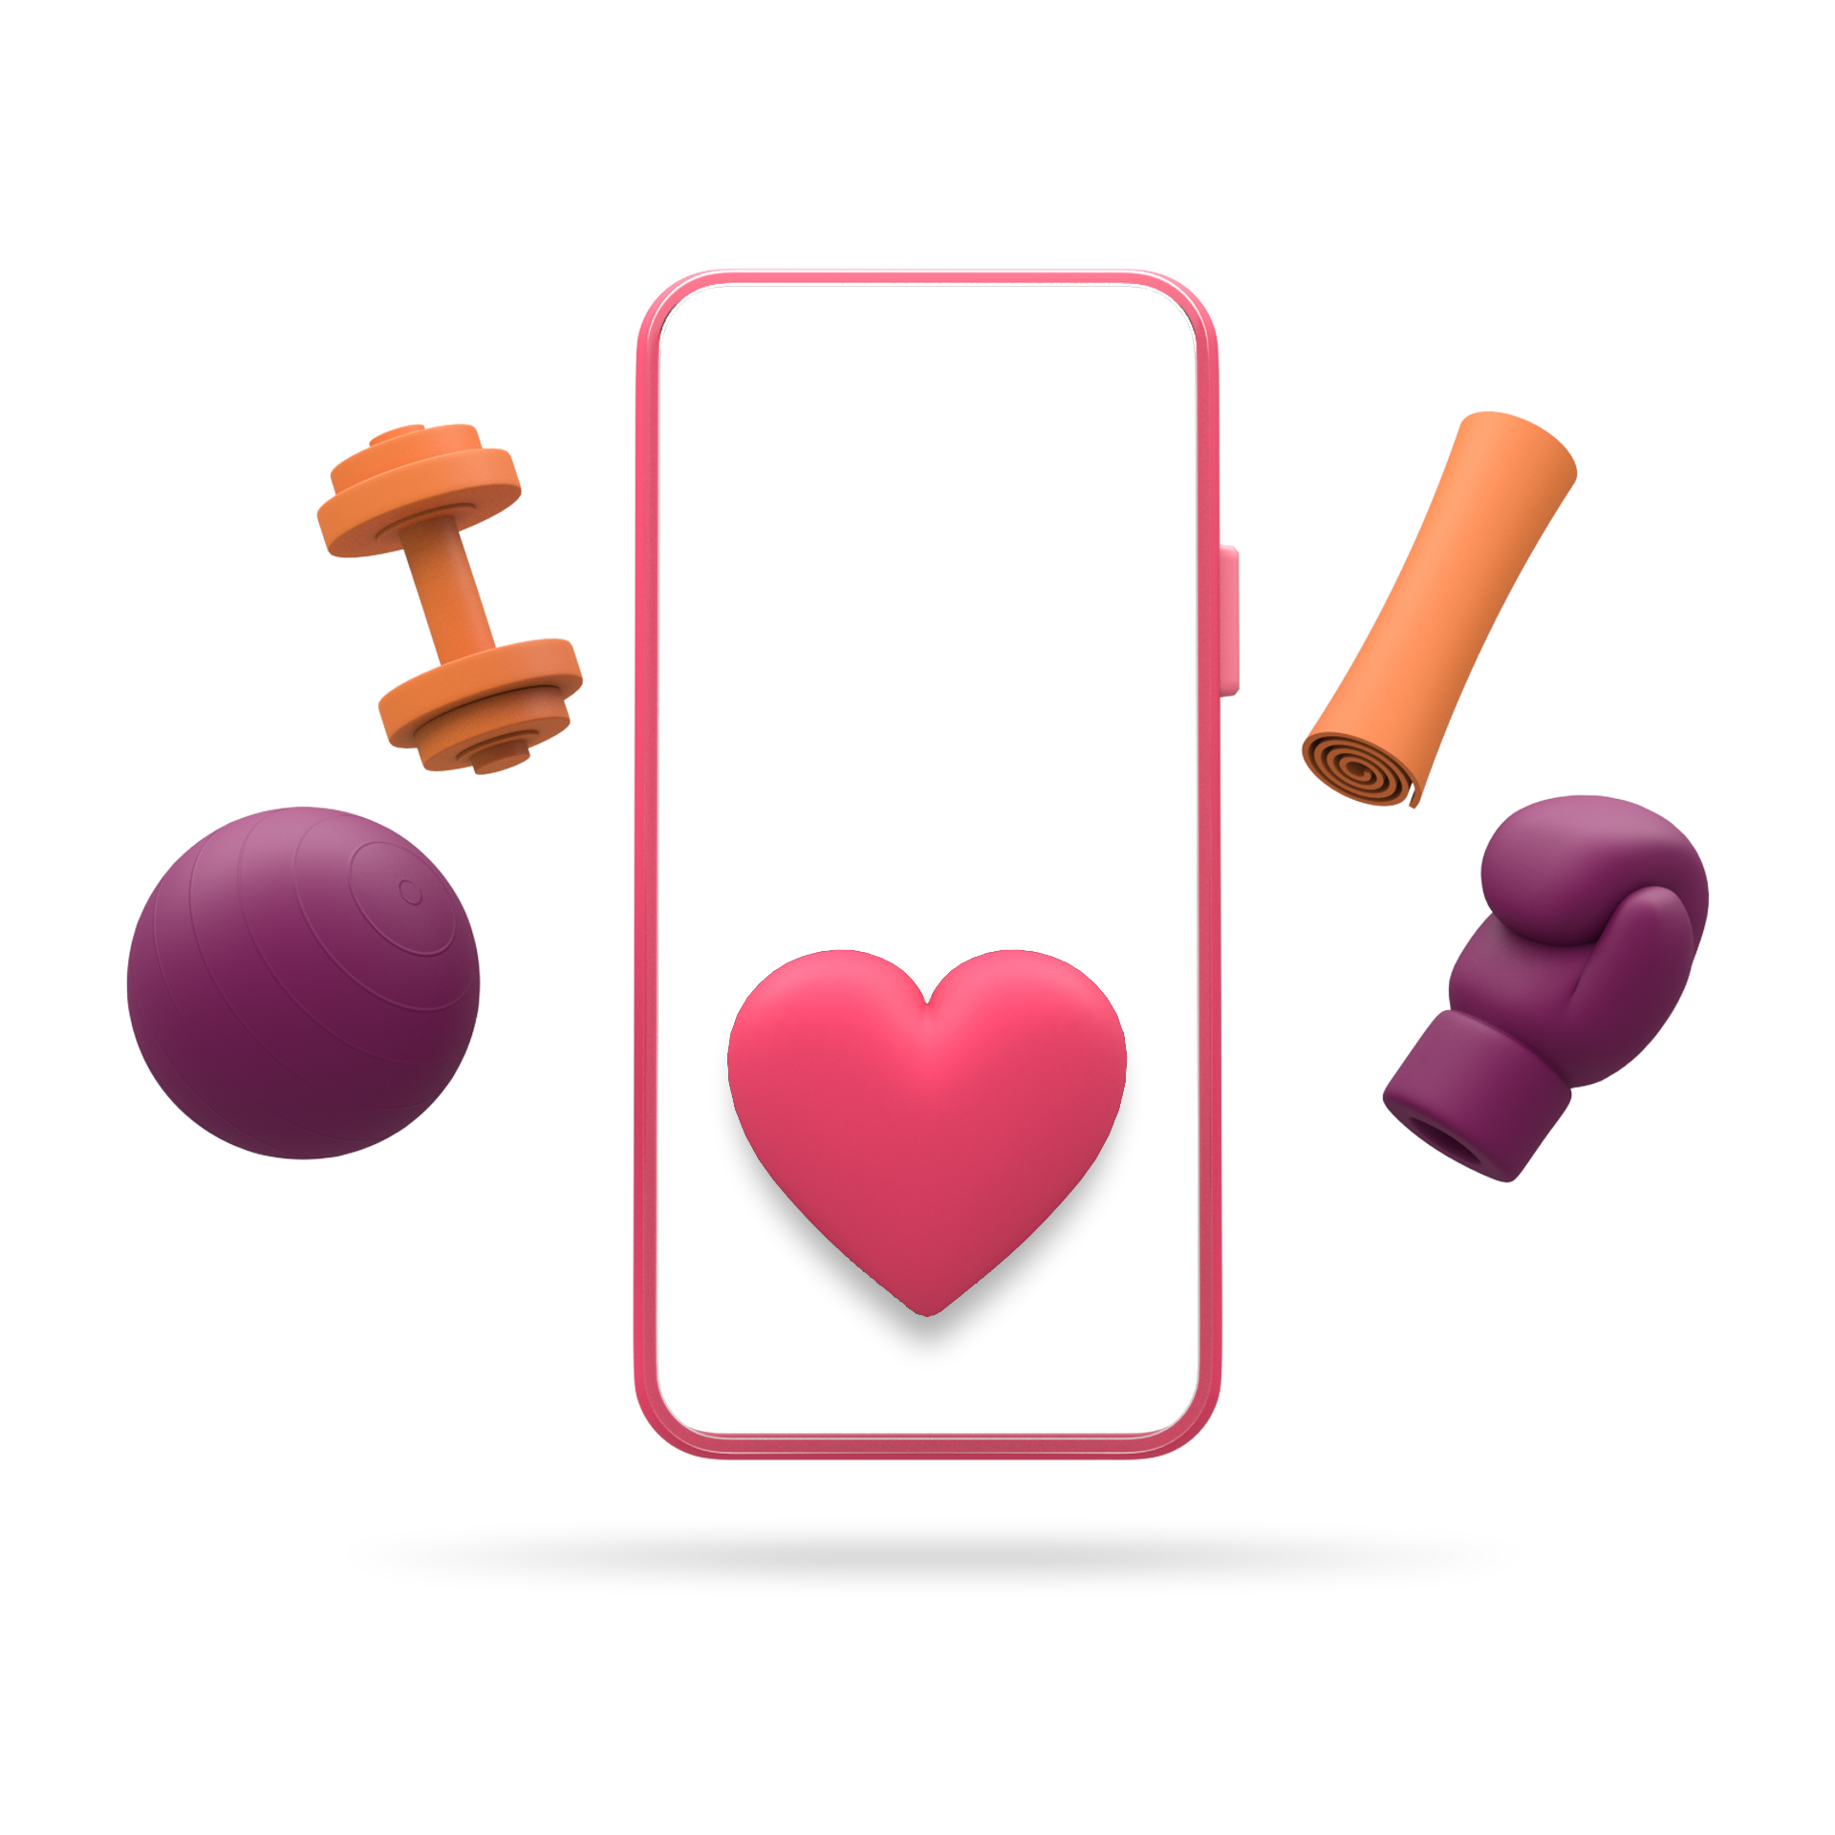
Live Classes
Enjoy thousands of live-stream workouts from your favorite gyms and studios!

Slide 13
Live Class Partners
..and many more!

Slide 14
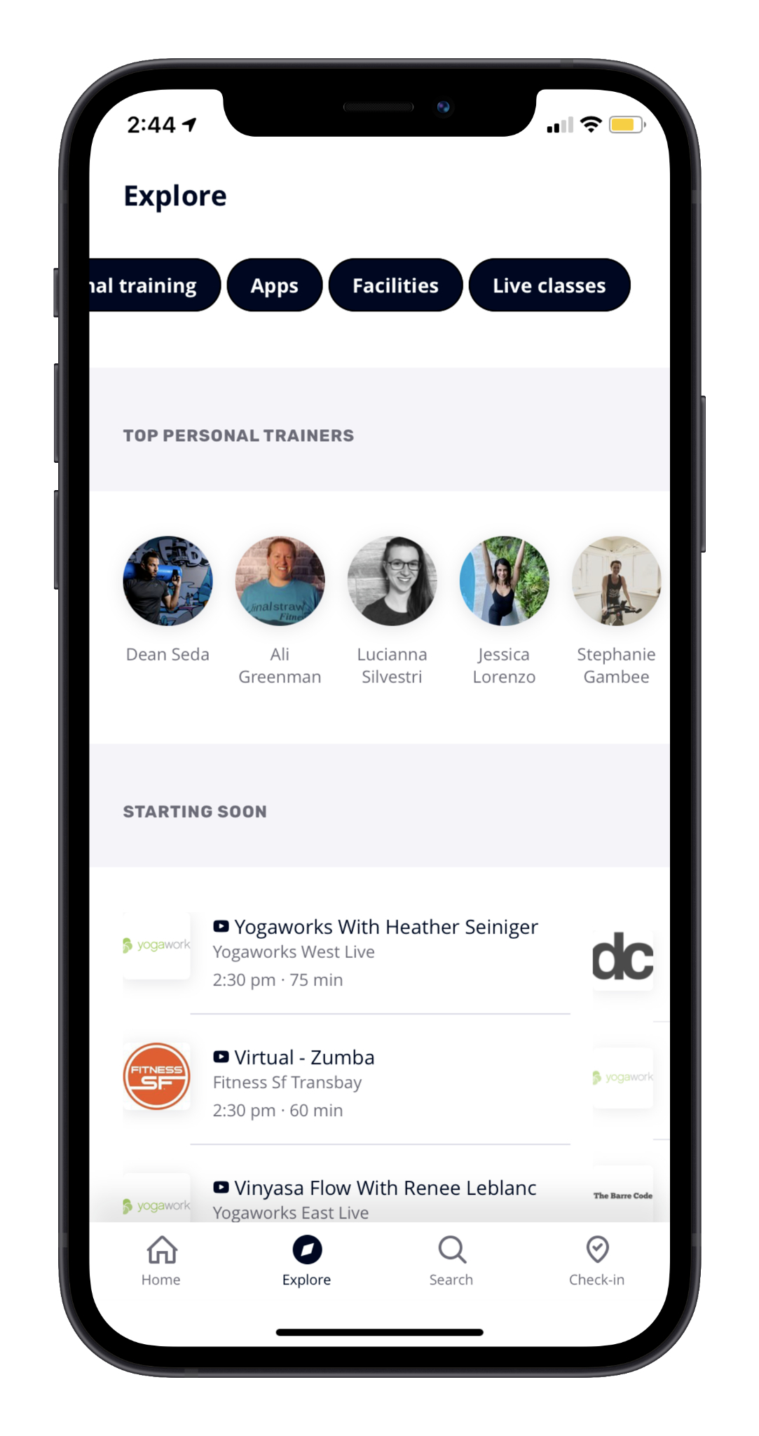
Navigating to Live Classes
Click “Explore”
Filter by “Live Classes”

Slide 15
With one Month-to-Month Membership
Gyms & Fitness Studios
Live Streamed
Classes
1-on-1
Personal Training
App Partners &
On Demand Workouts

Slide 16
Virtual Training
Get a customized workout and built in accountability on your fitness journey, through virtual 1:1 personal training.
Yoga | Meditation | Boxing | HIIT | Strength Training | Dance| Pilates | Family Workouts & More!

Slide 17
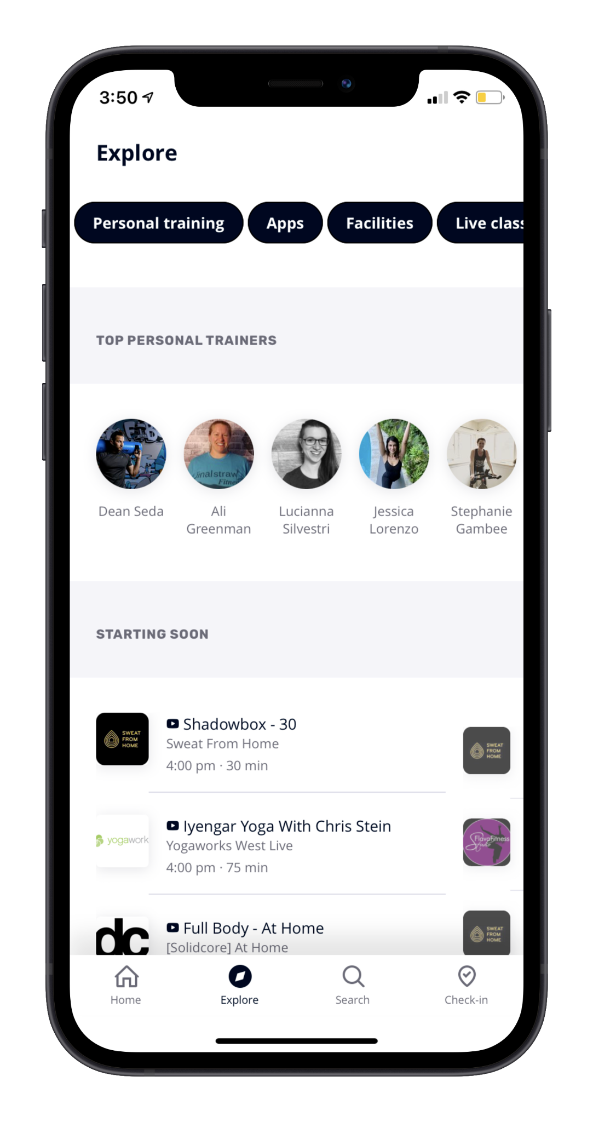
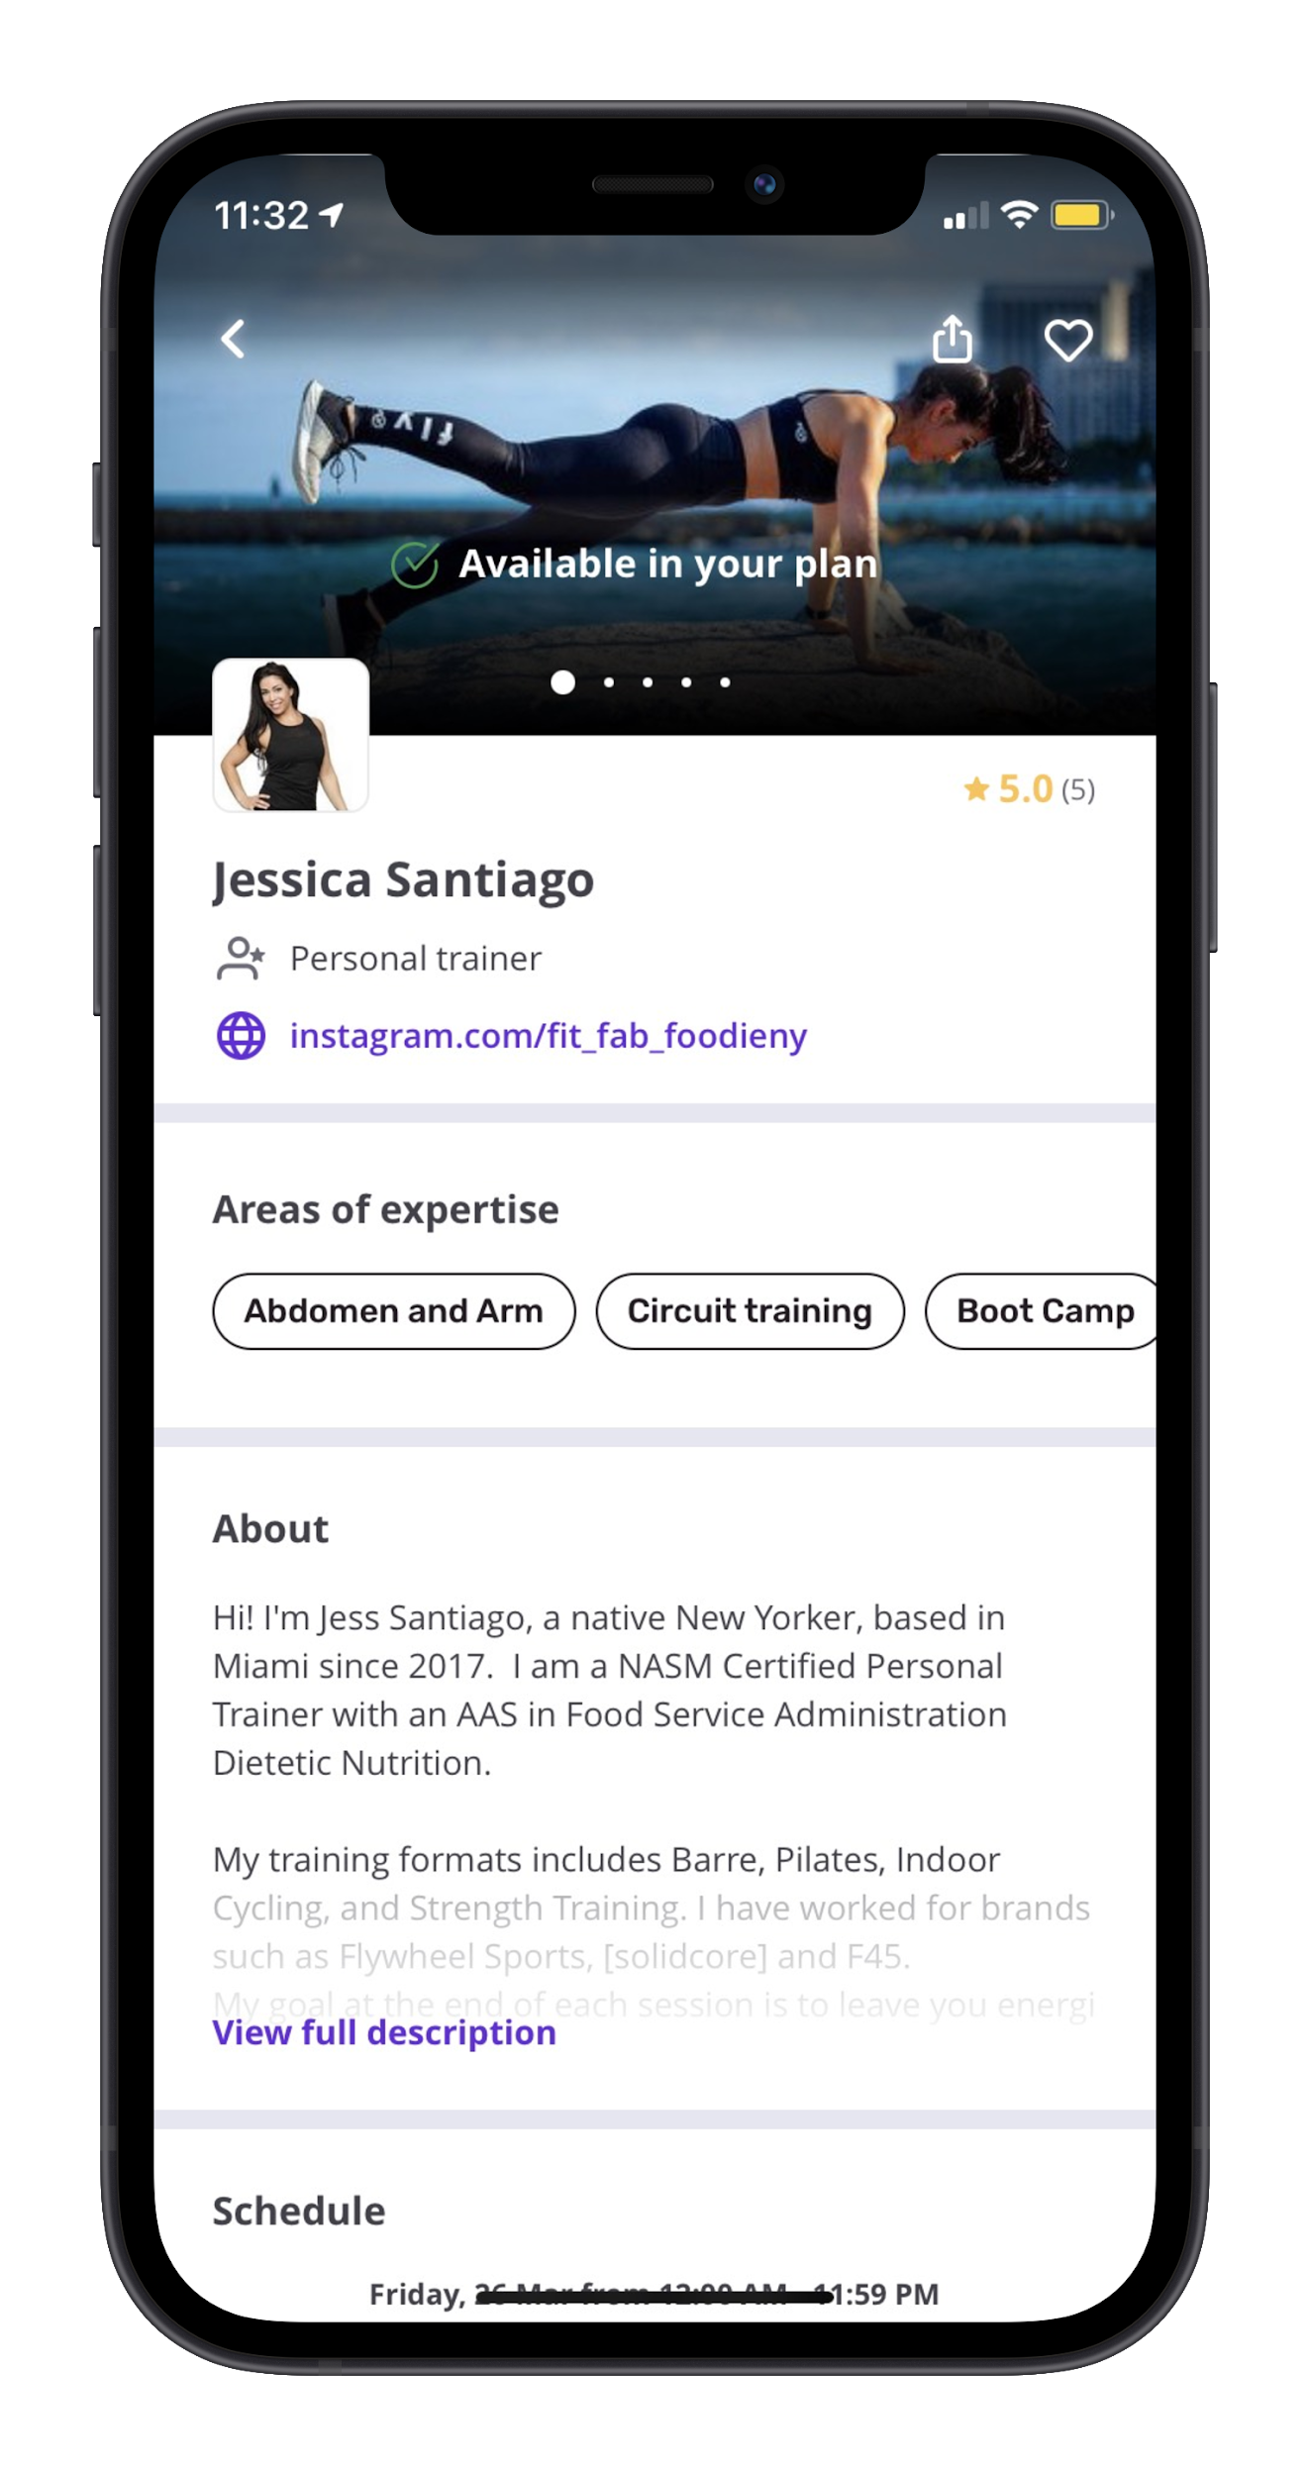
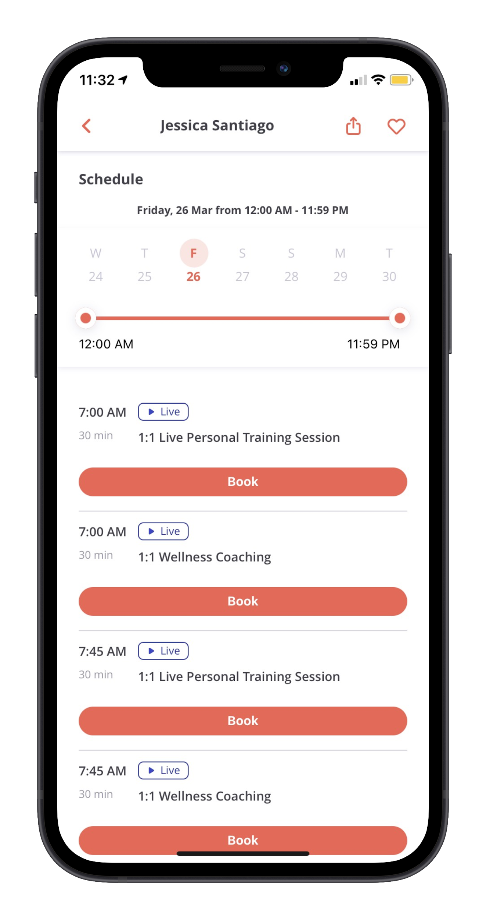
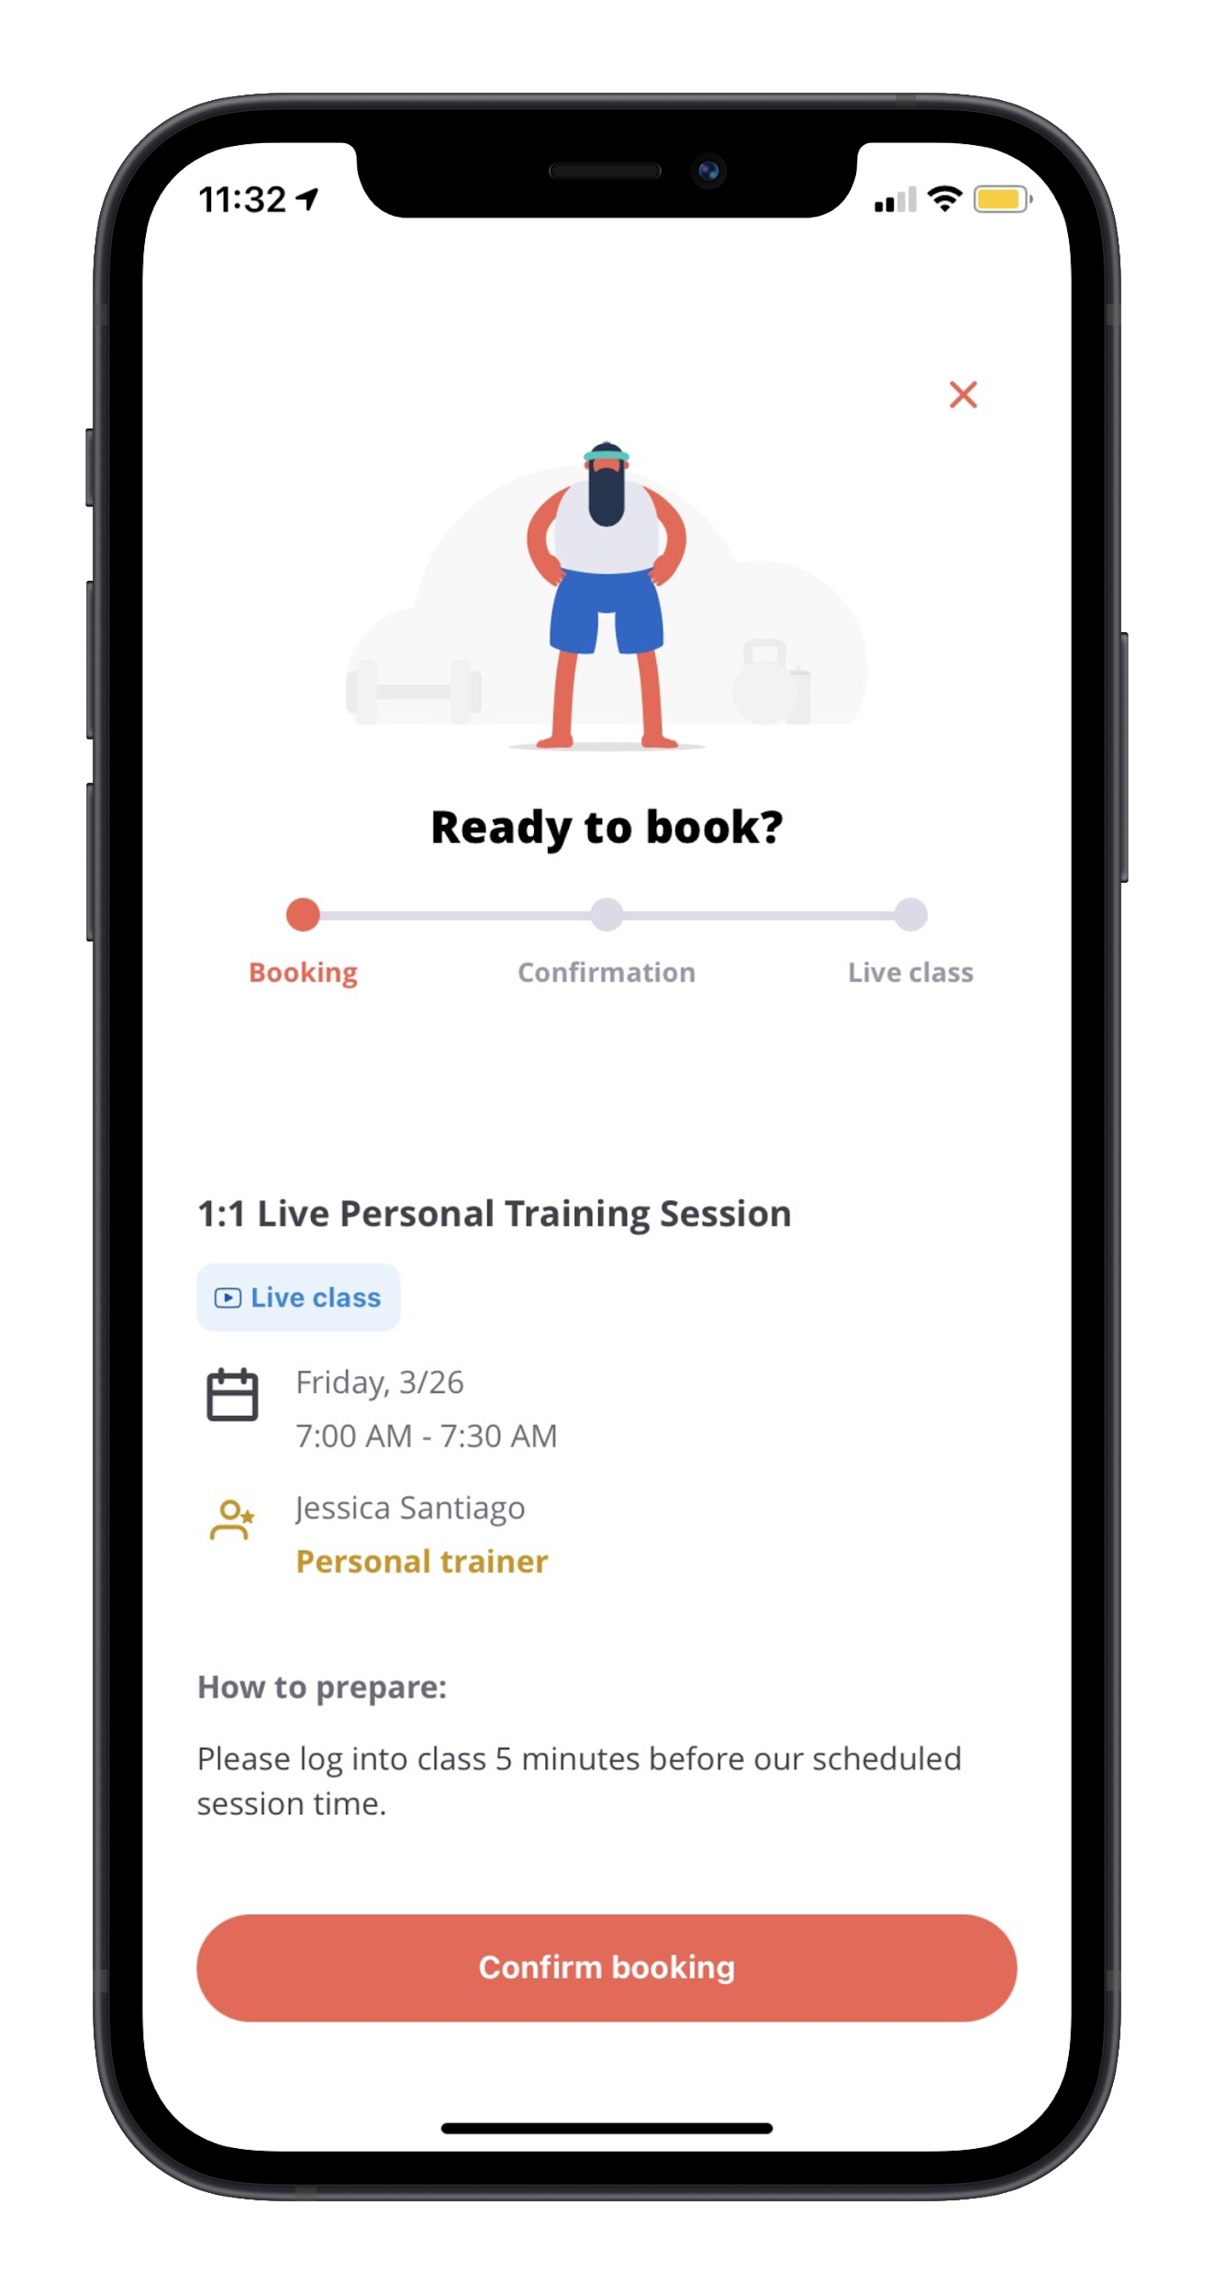
Navigating to book a Personal Training or Wellness Coach Session
Browse trainers and their bios to view and book available sessions
1
Explore→ Personal Training
2
Select profile of Personal Trainer → Review Areas of Expertise to confirm workout / discussion topic
Review date and time availability→ Select ‘Book’ on appropriate class type and time
Review details and select ‘Confirm booking’ to book your workout / discussion
3
4

Slide 18
With one Month-to-Month Membership
Gyms & Fitness Studios
Live Streamed
Classes
1-on-1
Personal Training
App Partners &
On Demand Workouts

Slide 19
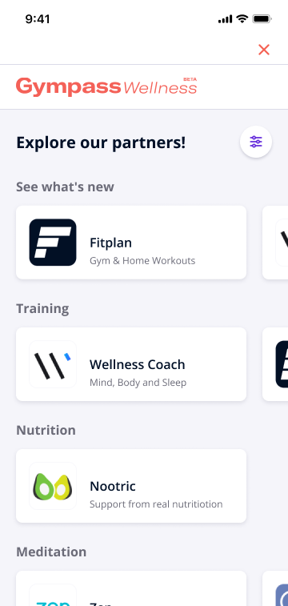
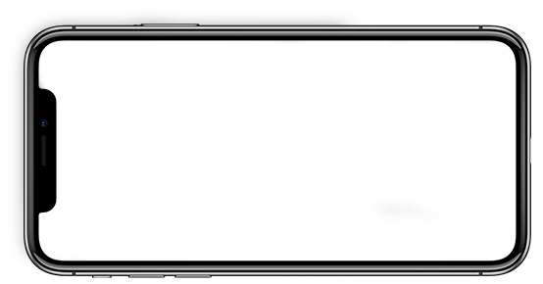
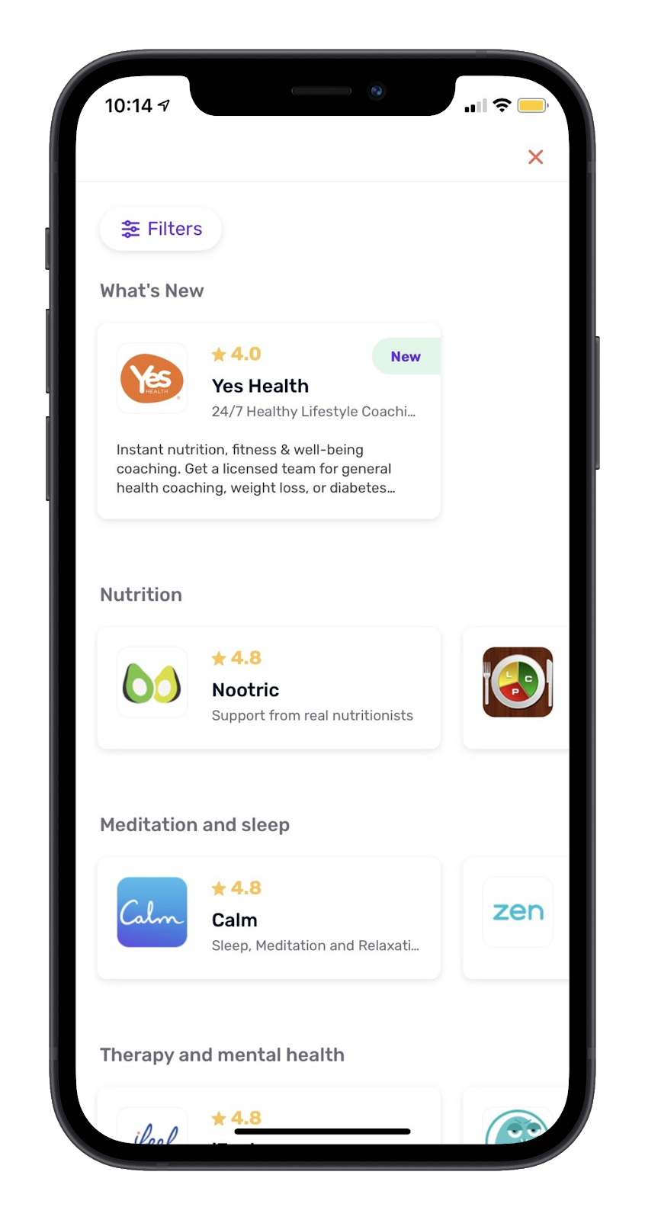
App Partners
35+ App Partners
On Demand Fitness Classes
Therapy
Meditation
Meal Prepping
Audio Guided Workouts
Nutrition
Kids + Family Fitness
and more!
Included in your membership!

Slide 20
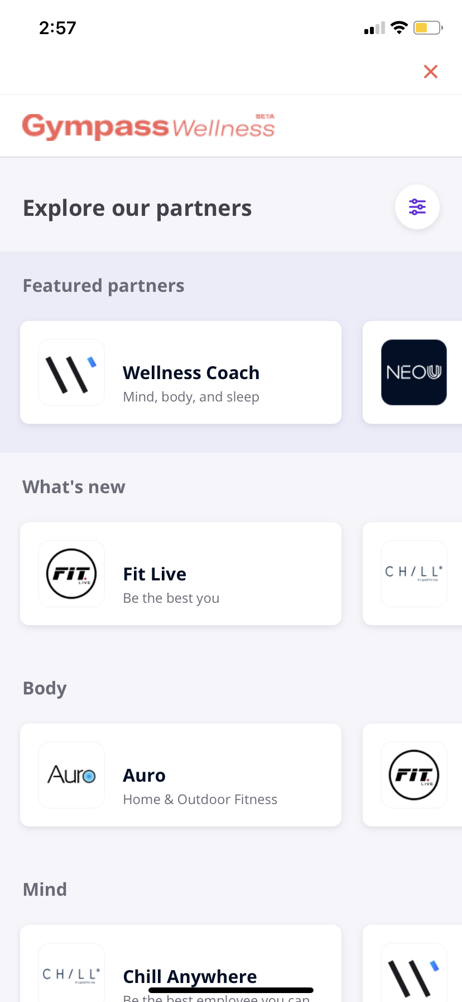
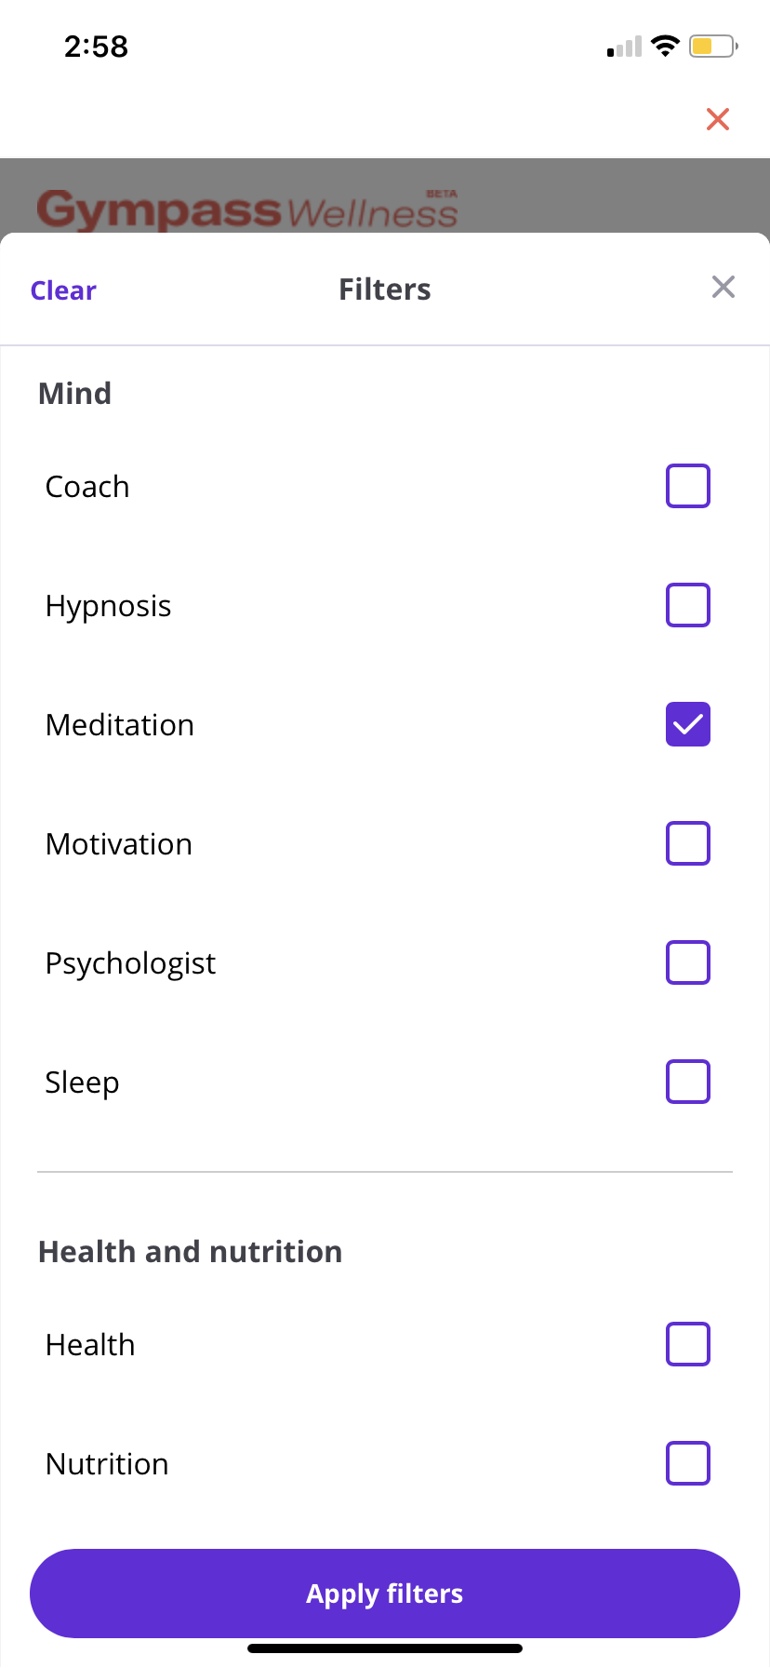
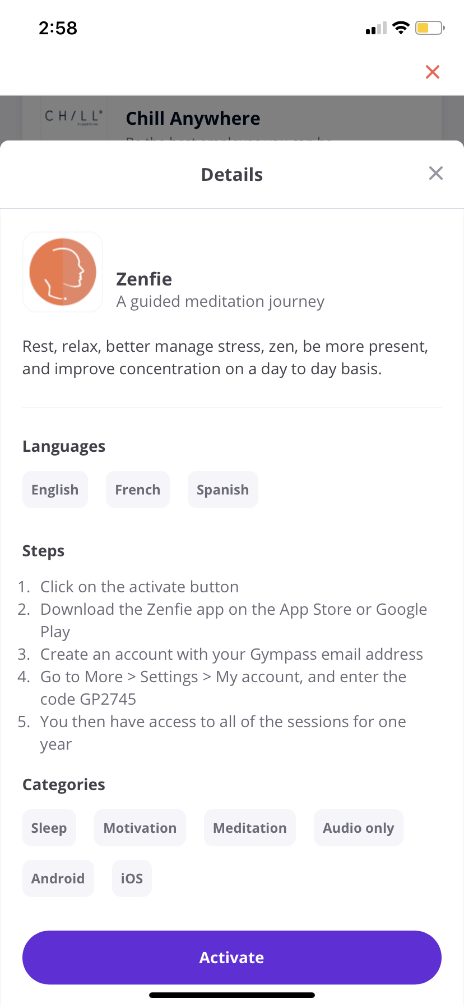
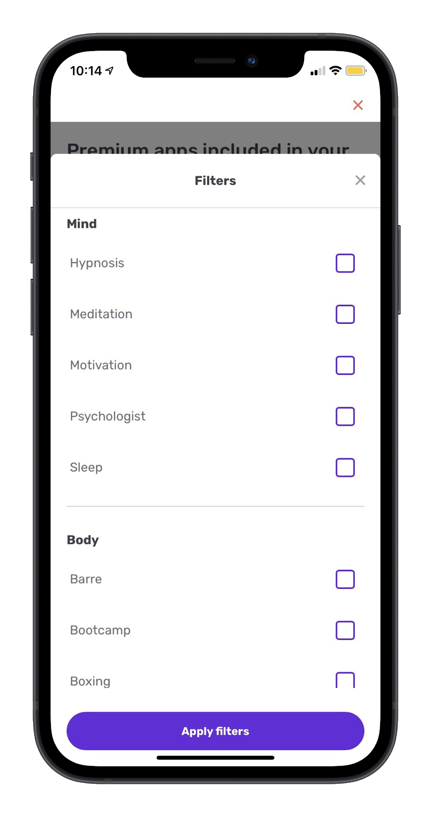
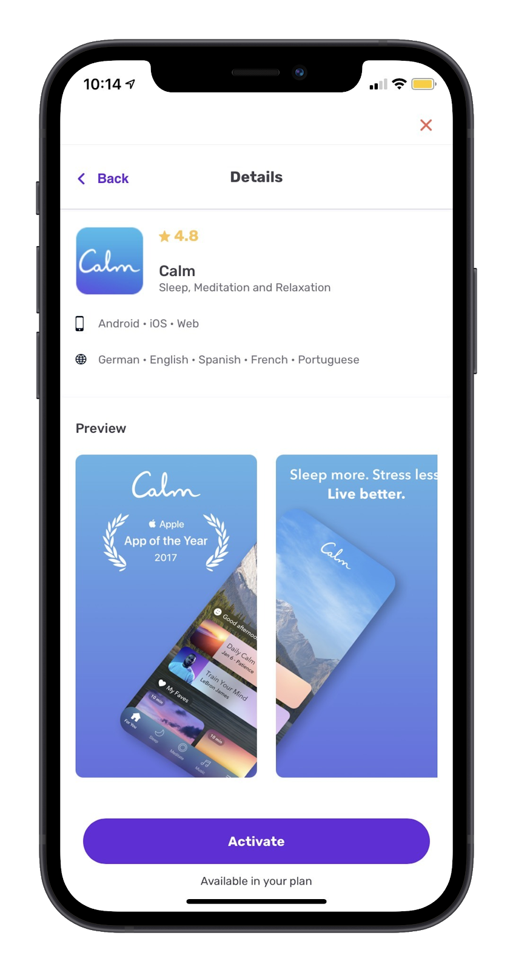
How to access Gympass Apps
1
Home → Wellness Apps
2
Filter Through Apps
3
Follow Instructions

Slide 21
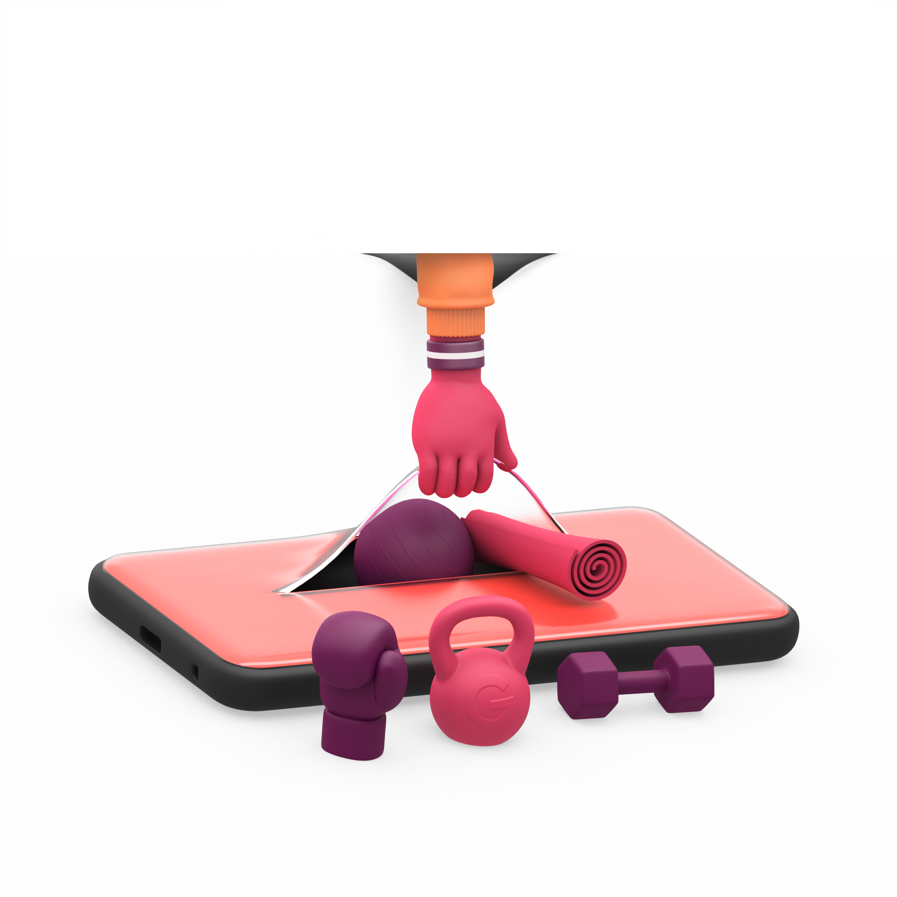
Enroll into a Gympass plan and enjoy a 7-day free trial.
Dependents Promotion:
Once you’re a member, refer dependents at employee rates. Employees & their dependents do not have to choose the same plan.

Slide 22
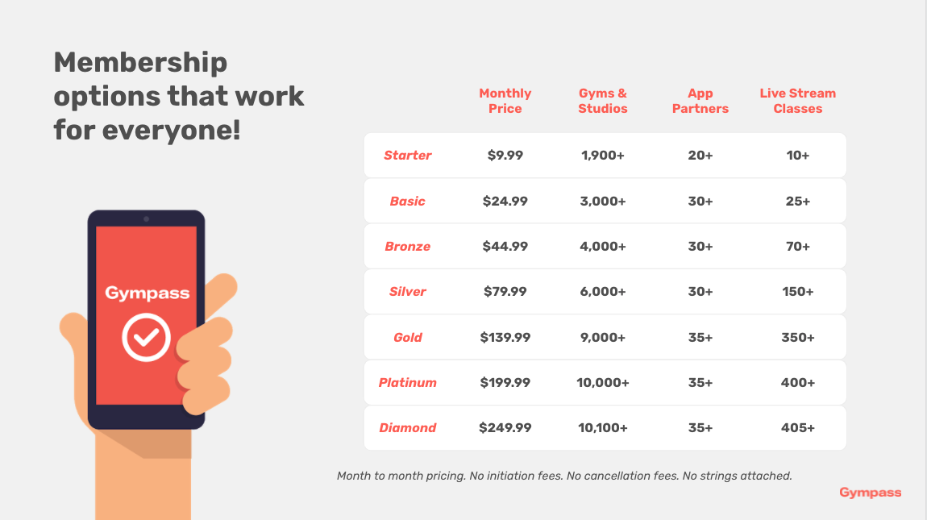
Pricing

Slide 23
The Top FAQs
I’d like to have a look at which gyms, live classes, personal trainers and app partners I can access before signing up. If I do this and decide Gympass is not for me, will I still be charged?
No, you will only be charged if you select a plan and proceed to checkout to complete your transaction. Creating an account is free, and you can view all the facilities from the Gympass App before purchasing a plan.
How can I determine which package is best for me?
To see all of the offerings provided in the Gympass network and by each pricing plan, create a free Gympass account through the Gympass App or website and search for gyms, studios, classes and app partners. You can filter according to your personal preferences such as activity, price, and location to better
understand what will work best for you.
Can I delay the start date/activate my account at a later date?
Plans are activated instantly upon payment receipt, after the initial free trial offer. We recommend purchasing on the day you want to begin membership.
How do I pay?
Depending on your company’s payment terms, payment is deducted automatically from your credit card or payroll. Once you enroll in a Gympass plan, you will enter and agree to the payment terms to begin your plan. As a reminder, your first 7 days are completely FREE and you will see that reflected within your enrollment terms.

Slide 24
The Top FAQs
Can I change my plan? If yes, how often may I do so?
Yes! Once you’re in the app, use the profile dropdown arrow at the top of the home page and select “Plan Management.” If you downgrade, the active plan at the time of change will continue through the end of the monthly billing cycle. If you upgrade, you will be charged a prorated fee of the upgraded plan price difference, depending on how many days you have left in your billing cycle.
I’m going away for a while, can I freeze my membership?
You can pause your plan and receive a credit for the remaining days of your active membership. Just restart your membership whenever you are ready. You can also cancel and re enroll at anytime. There are no penalties or fees associated with cancelling or restarting.
Can I change my payment date?
Once you sign up, you are not able to change the date that your plan is renewed. If you need to make a change, the best thing to do is cancel your current plan, then repurchase on the date you want regular payments to be taken.
What is the membership cancellation policy? Is there a charge?
You can cancel your plan or participation at any time, at no charge. Click on the profile dropdown arrow at the top of the home page in the app and select “Plan Management” to cancel your current membership. You will be able to access fitness facilities as normal until the end date of your current billing cycle. Monthly billing will end once you have confirmed cancellation. Plans renew monthly with no minimum term or contract length.

Slide 25
The Top FAQs
After the billing date, if I forget to make any changes to my plan is there a grace period?
There is no grace period. Users who sign up will assume the responsibility to manage their account. We encourage users to set a notification in their calendar 29 days from purchase of plan, in case they need to alter their plan prior to the next monthly billing date.
Can I share Gympass with my family members?
Yes! Once you activate your plan, swipe through the top banner in the home page of the app and select “See Dependents”. *You can choose any plan for a dependent and enter in a separate credit card payment if you like. Simply complete their information, choose their plan and payment ad your dependents will receive a welcome email from Gympass.
*A dependent is defined as your spouse, domestic partner or dependent child.
My favorite gym/studio isn’t part of Gympass network, can I add it?
We take (and love) referrals! Our Gym Partnerships team is constantly working to expand our already growing network. Just log into your free Gympass account to send your referral! Don’t worry about enrolling in a plan, you don’t need to have an active Gympass membership to send referrals. When in the
Gympass App, click on the dropdown arrow at the top right corner. Scroll down until you see ‘Refer a facility’. Give us any information you have and we’ll update you if it is added to the Gympass network.

Slide 26
The Top FAQs
How quickly will my referred facility be included in the Gympass network?
Your request is sent directly to our Gympass partnerships team. Network additions vary from gym to gym. There are no guarantees that a gym will be added to the network... but we will do our best.
I’m already a member of one of the facilities within the Gympass network. Can I transfer my membership over to Gympass?
We are unable to merge a current contract with a Gympass plan, as we have no control over individual gym/studio contracts*. Depending on the terms of your contract, you may need to ﬁnish out your current membership and then sign up for Gympass, or keep both active and use Gympass at other partner facilities.
*Please note, Gympass does not buy out contracts or pay any cancellation fees for an individual membership.
How do I book a class/activity?
Simply visit the speciﬁc ﬁtness facility’s proﬁle via the Gympass App or website, and follow the instructions provided for each facility. Many classes can be booked right through the App, but for some locations you may need to call or email the gym or studio. If you would like to book a virtual Live Class, click on the “Explore” tab in the app to view what is available.

Slide 27
The Top FAQs
What happens if I don’t show up for a class/activity?
If you sign up for a class/activity, but are unable to attend, you will have used your daily check-in, and will not be able to check into another facility. If you cannot attend a class you have booked, make sure you cancel within the cancellation window speciﬁed on our website*.
*Please note, if you cancel within the facility’s cancellation window, you will still have a daily check-in use available for that day.
What happens if my employment ends?
Once we receive conﬁrmation that your employment has ended, you will receive an email from Gympass explaining any changes to your membership. You will keep your discount until the end of the current billing cycle. Once you have reached the next monthly billing date, you will have the option to purchase Gympass plans without the company discount. Gympass will reach out to you and provide options during this time. Please contact Gympass Customer
How do the personal training sessions work?
You will now be able to book 1:1 training sessions with our Gympass trainers. Each of the sessions are 30 minutes long and are all virtual. All you need to do is reserve your session with one of our trainers right on the Gympass app and you will receive a conﬁrmation email with a link to join your session.

Slide 28
The Top FAQs
Is there a limitation on how many times I can use a personal trainer?
You will be able to book 8 personal training sessions per month. Each personal training session that you take will count as your “check in” for the day.
Is there a limitation to how many Gympass Wellness applications you use?
There is no limitation on how many of our apps you download or use. You are able to download any of the apps included in your plan. There is also no limitation on how many times you use the workouts provided to you through those apps.
If you do a workout using an Gympass Wellness app, does that count for your daily check-in?
No, Wellness applications will not count toward you daily check-in. You are able to use your daily check in toward a live class, personal training session, or going to a facility. You are however able to use the Wellness apps are much as you would like without limitation.
Can I go to a facility in the morning and then do a live streamed class in the evening?
Currently, Gympass is restricted to one use per day. This includes in person gym visits, live streamed classes and personal training sessions. You can access our app partners anytime!

Slide 29
We’re here to help. Keep in touch!
Questions?
Go to "Help Center” in the app

Slide 30
Thank you &
Welcome to Gympass!
Let’s find an activity to love!

